Slide 1
Chapter 3 Alkanes: Nomenclature, Conformational Analysis, and an Introduction to Synthesis

Slide 2
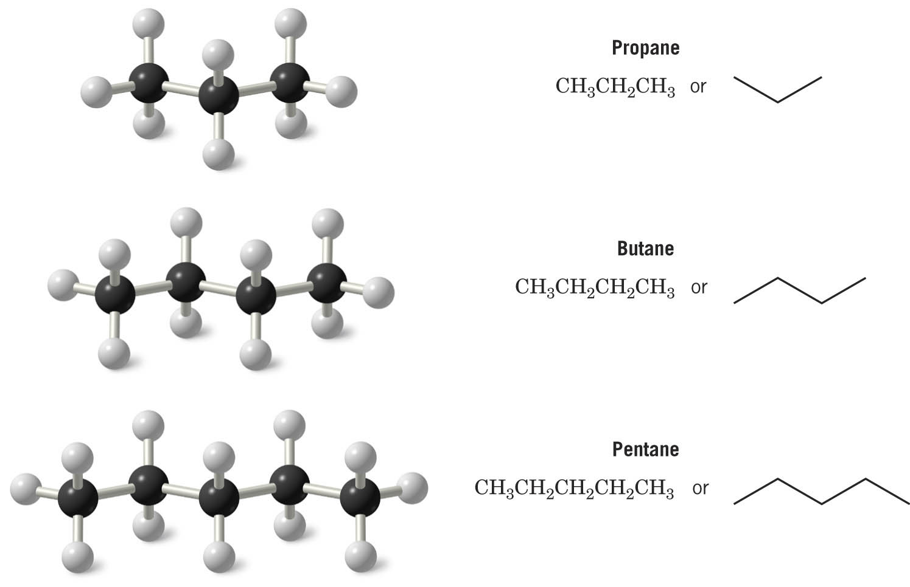
Shapes of Alkanes
“Straight-chain” alkanes have a zig-zag orientation when they are in their most straight orientation
Straight chain alkanes are also called unbranched alkanes

Slide 3
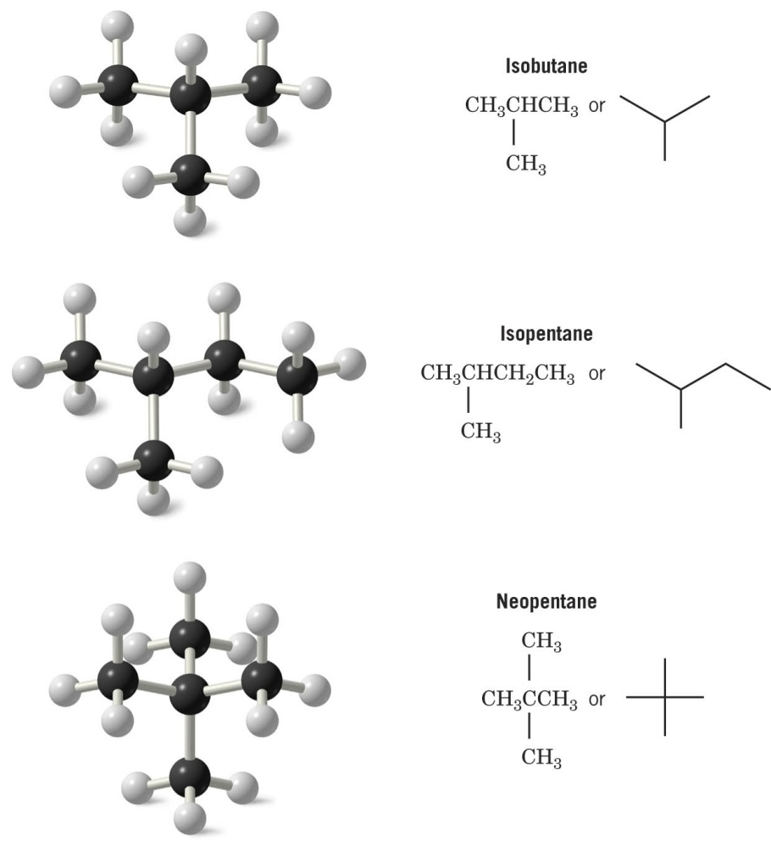
Branched alkanes have at least one carbon which is attached to more than two other carbons

Slide 4
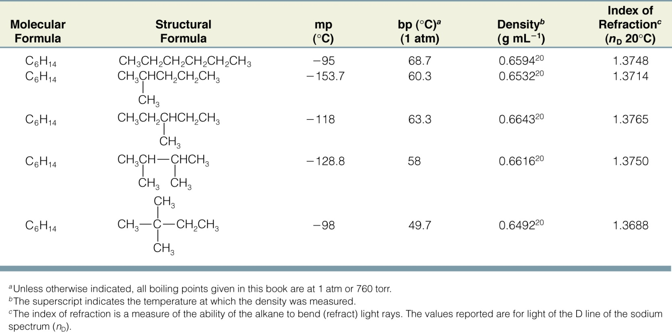
Constitutional isomers have different physical properties (melting point, boiling point, densities etc.)
Constitutional isomers have the same molecular formula but different connectivity of atoms

Slide 5
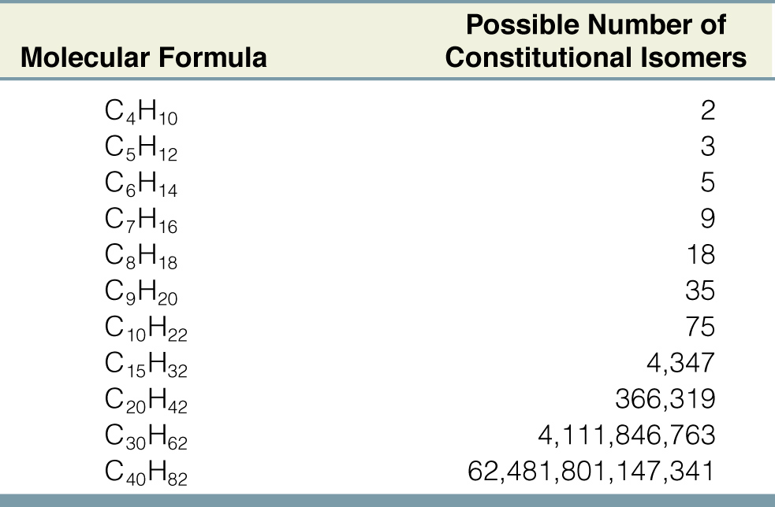
The number of constitutional isomers possible for a given molecular formula increases rapidly with the number of carbons

Slide 6
IUPAC Nomenclature of Alkanes, Alkyl Halides and Alcohols
Before the end of the 19th century compounds were named using nonsystematic nomenclature
These “common” or “trivial” names were often based on the source of the compound or a physical property
The International Union of Pure and Applied Chemistry (IUPAC) started devising a systematic approach to nomenclature in 1892
The fundamental principle in devising the system was that each different compound should have a unique unambiguous name
The basis for all IUPAC nomenclature is the set of rules used for naming alkanes

Slide 7
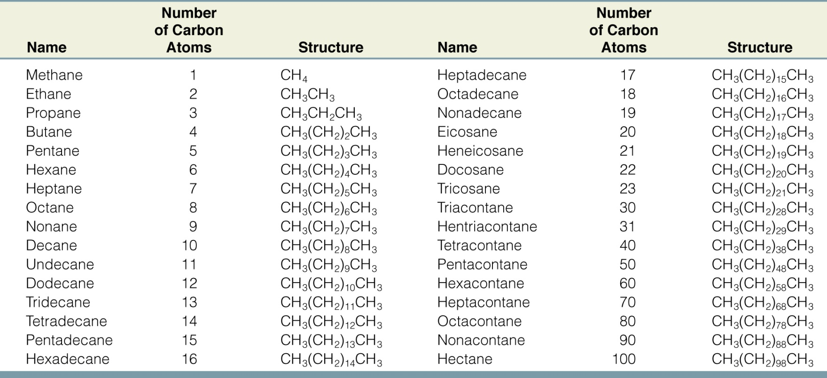
Nomenclature of Unbranched Alkanes

Slide 8
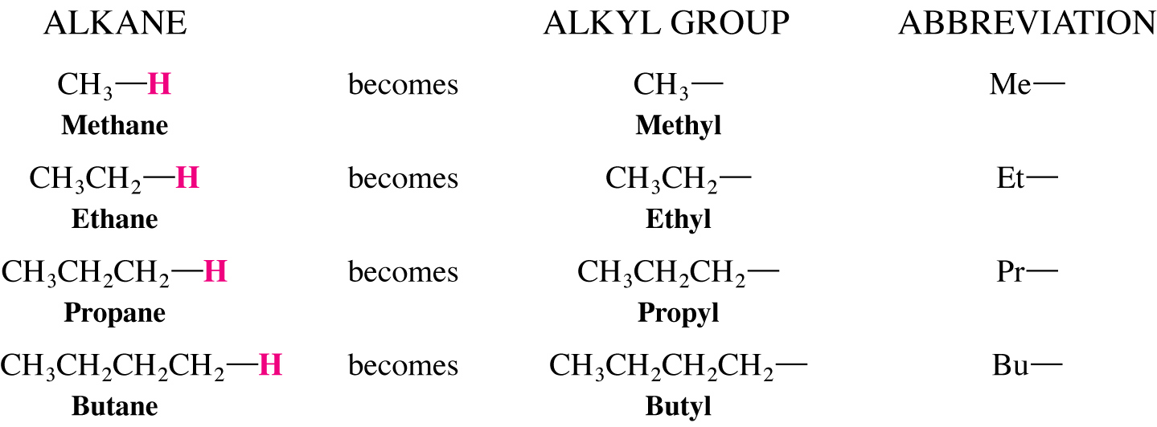
Nomenclature of Unbranched Alkyl groups
The unbranched alkyl groups are obtained by removing one hydrogen from the alkane and named by replacing the -ane of the corresponding alkane with -yl

Slide 9
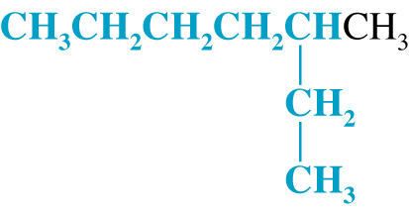
Nomenclature of Branched-Chain Alkanes (IUPAC)
Locate the longest continuous chain of carbons; this is the parent chain and determines the parent name.
Number the longest chain beginning with the end of the chain nearer the substituent
Designate the location of the substituent
When two or more substituents are present, give each substituent a number corresponding to its location on the longest chain
Substituents are listed alphabetically

Slide 10
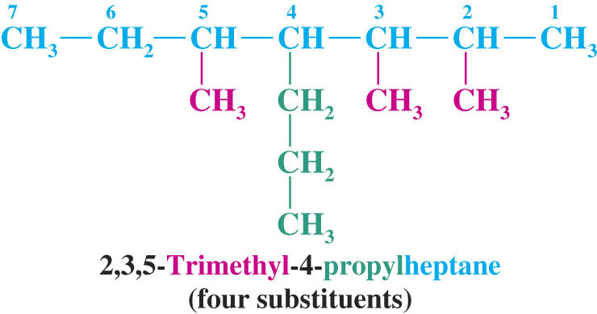
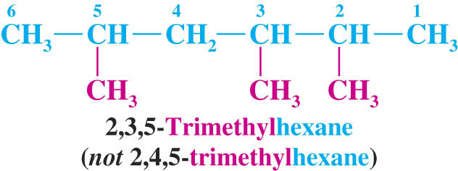
When two or more substituents are identical, use the prefixes di-, tri-, tetra- etc.
Commas are used to separate numbers from each other
The prefixes are used in alphabetical prioritization
When two chains of equal length compete to be parent, choose the chain with the greatest number of substituents
When branching first occurs at an equal distance from either end of the parent chain, choose the name that gives the lower number at the first point of difference

Slide 11
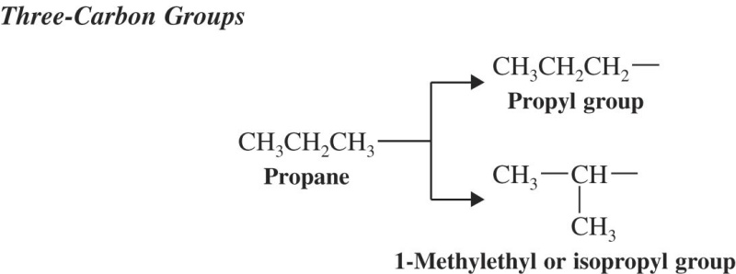
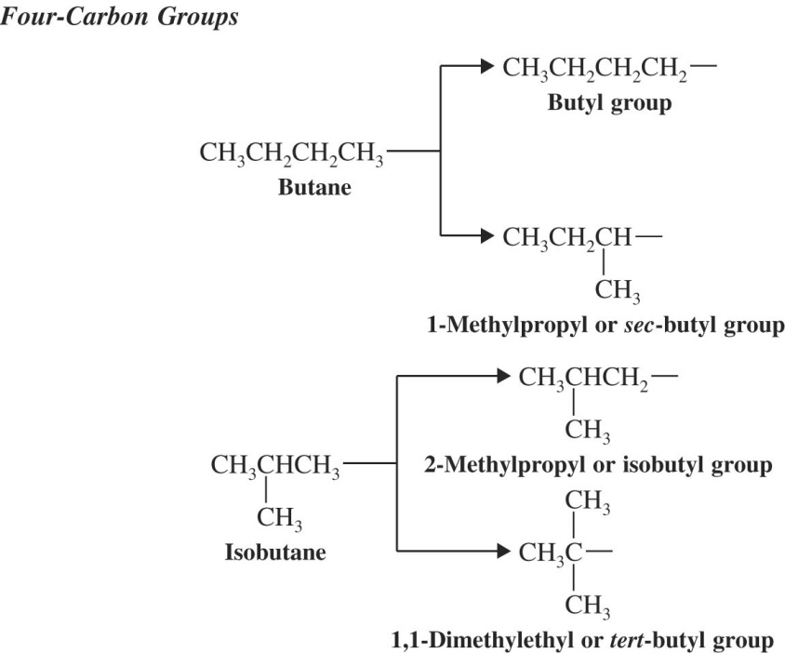
Nomenclature of Branched Alkyl Chains
Two alkyl groups can be derived from propane
Four groups can be derived from the butane isomers

Slide 12
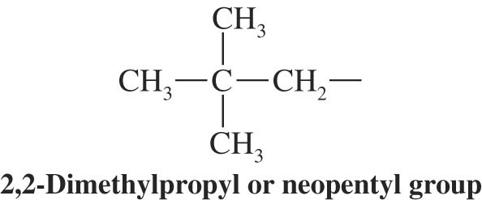
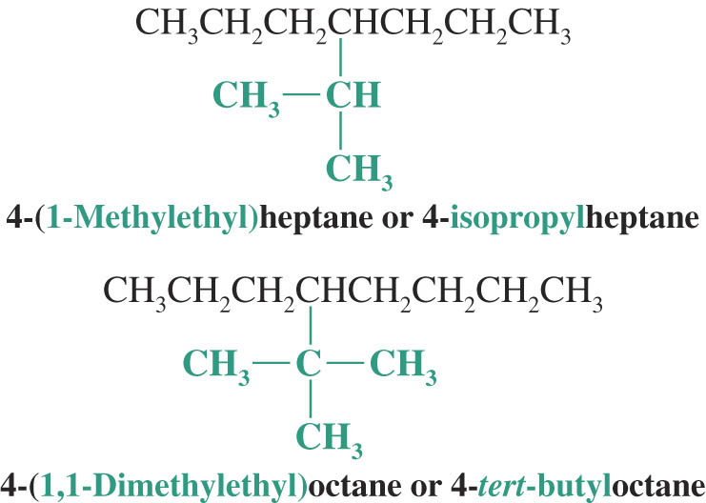
The neopentyl group is a common branched alkyl group
Examples

Slide 13
Classification of Hydrogen Atoms
Hydrogens take their classification from the carbon they are attached to

Slide 14
Nomenclature of Alkyl Halides
In IUPAC nomenclature halides are named as substituents on the parent chain
Halo and alkyl substituents are considered to be of equal ranking
In common nomenclature the simple haloalkanes are named as alkyl halides
Common nomenclature of simple alkyl halides is accepted by IUPAC and still used

Slide 15
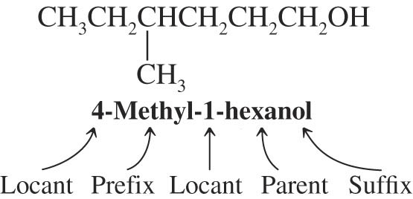
IUPAC Substitutive Nomenclature
An IUPAC name may have up to 4 features: locants, prefixes, parent compound and suffixes
Numbering generally starts from the end of the chain which is closest to the group named in the suffix
IUPAC Nomenclature of Alcohols
Select the longest chain containing the hydroxyl and change the suffix name of the corresponding parent alkane from -ane to -ol
Number the parent to give the hydroxyl the lowest possible number
The other substituents take their locations accordingly

Slide 16
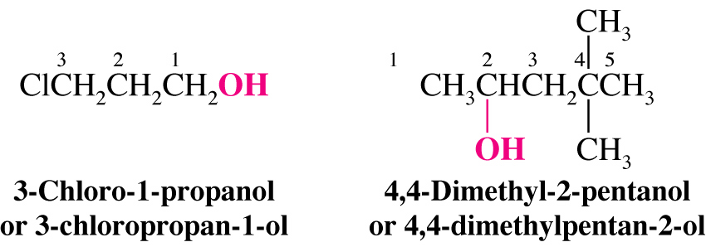
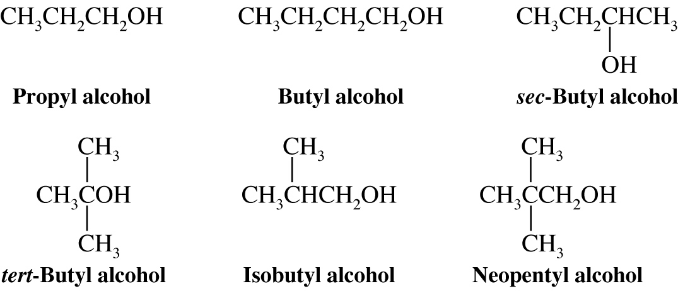
Examples
Common Names of simple alcohols are still often used and are approved by IUPAC

Slide 17
Alcohols with two hydroxyls are called diols in IUPAC nomenclature and glycols in common nomenclature

Slide 18
Nomenclature of Cycloalkanes
The prefix cyclo- is added to the name of the alkane with the same number of carbons
When one substituent is present it is assumed to be at position one and is not numbered
When two alkyl substituents are present the one with alphabetical priority is given position 1
Numbering continues to give the other substituent the lowest number
Hydroxyl has higher priority than alkyl and is given position 1
If a long chain is attached to a ring with fewer carbons, the cycloalkane is considered the substituent

Slide 19
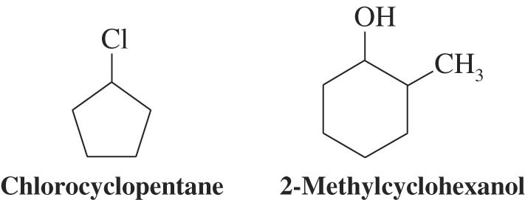

Slide 20
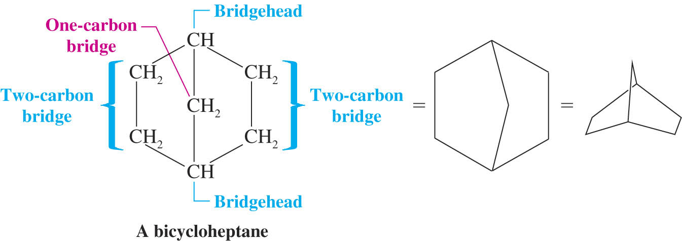
Bicyclic compounds
Bicyloalkanes contain 2 fused or bridged rings
The alkane with the same number of total carbons is used as the parent and the prefix bicyclo- is used
The number of carbons in each bridge is included in the middle of the name in square brackets

Slide 21
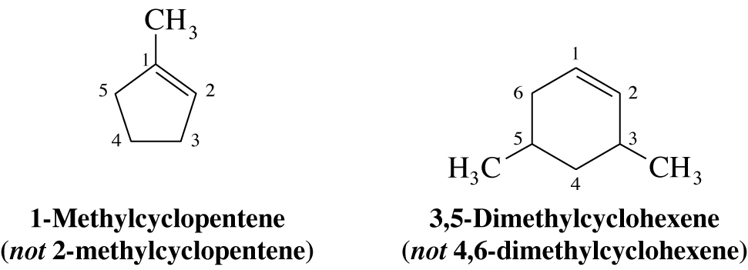
Nomenclature of Alkenes and Cycloalkenes
Alkenes are named by finding the longest chain containing the double bond and changing the name of the corresponding parent alkane from -ane to -ene
The compound is numbered to give one of the alkene carbons the lowest number
The double bond of a cylcoalkene must be in position 1 and 2

Slide 22
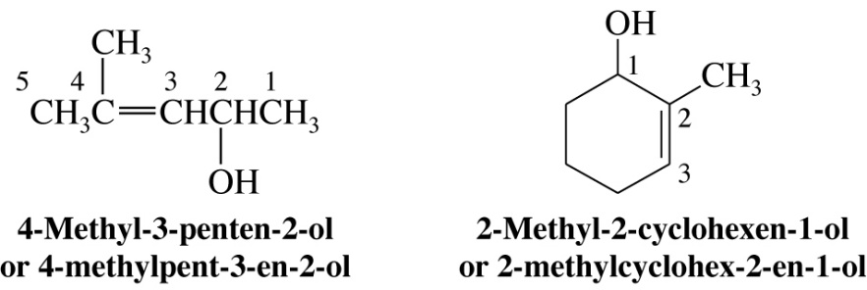
Compounds with double bonds and alcohol hydroxyl groups are called alkenols
The hydroxyl is the group with higher priority and must be given the lowest possible number
Two groups which contain double bonds are the vinyl and the allyl groups

Slide 23
If two identical groups occur on the same side of the double bond the compound is cis
If they are on opposite sides the compound is trans
Several alkenes have common names which are recognized by IUPAC

Slide 24
Sigma Bonds and Bond Rotation
Ethane has relatively free rotation around the carbon-carbon bond
The staggered conformation has C-H bonds on adjacent carbons as far apart from each other as possible
The drawing to the right is called a Newman projection
The eclipsed conformation has all C-H bonds on adjacent carbons directly on top of each other

Slide 25
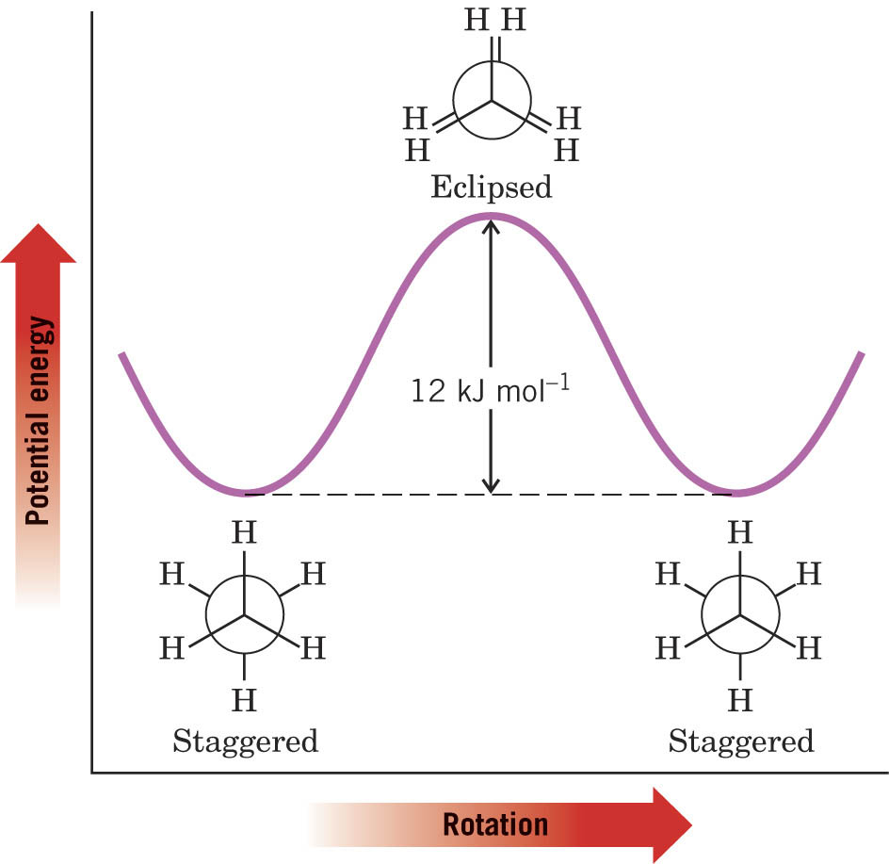
The potential energy diagram of the conformations of ethane shows that the staggered conformation is more stable than eclipsed by 12 kJ mol⁻¹

Slide 26
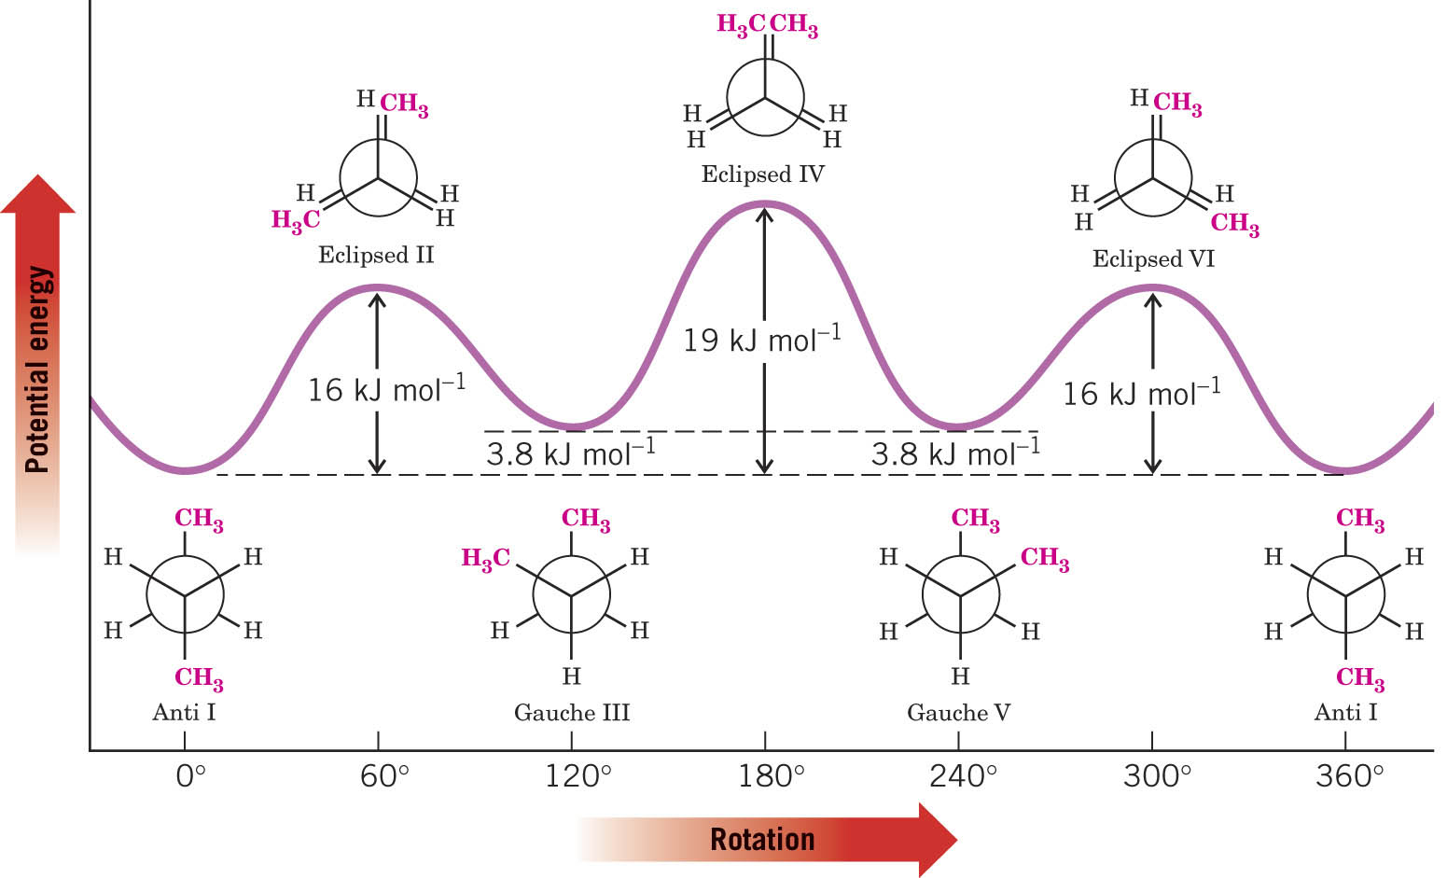
Conformational Analysis of Butane
Rotation around C₂-C₃ of butane gives six important conformations
The gauche conformation is less stable than the anti conformation by 3.8 kJ mol⁻¹ because of repulsive van der Waals forces between the two methyls

Slide 27
The Origin of Ring Strain in Cyclopropane and Cyclobutane : Angle Strain and Tortional Strain
Angle strain is caused by bond angles different from 109.5º
Tortional strain is caused by eclipsing C-H bonds on adjacent carbons
Cyclopropane has both high angle and tortional strain
Cyclobutane has considerable angle strain
It bends to relieve some tortional strain
Cyclopentane has little angle strain in the planar form but bends to relieve some tortional strain

Slide 28
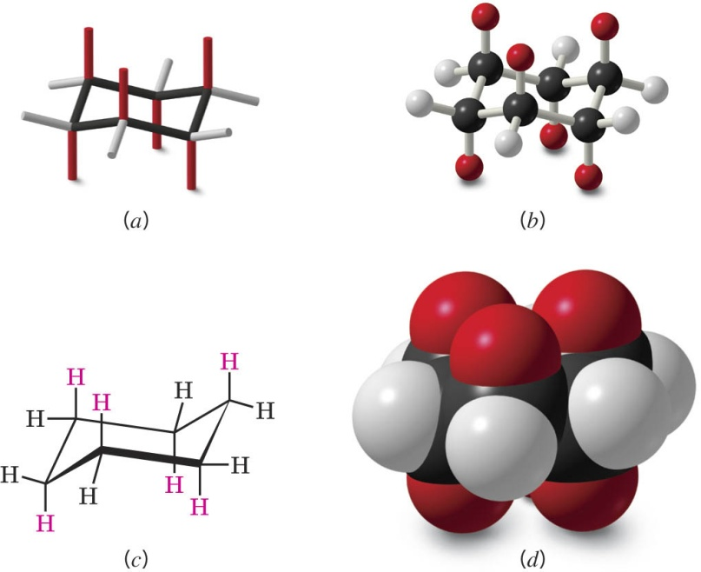
Conformations of Cyclohexane
The chair conformation has no ring strain
All bond angles are 109.5º and all C-H bonds are perfectly staggered

Slide 29
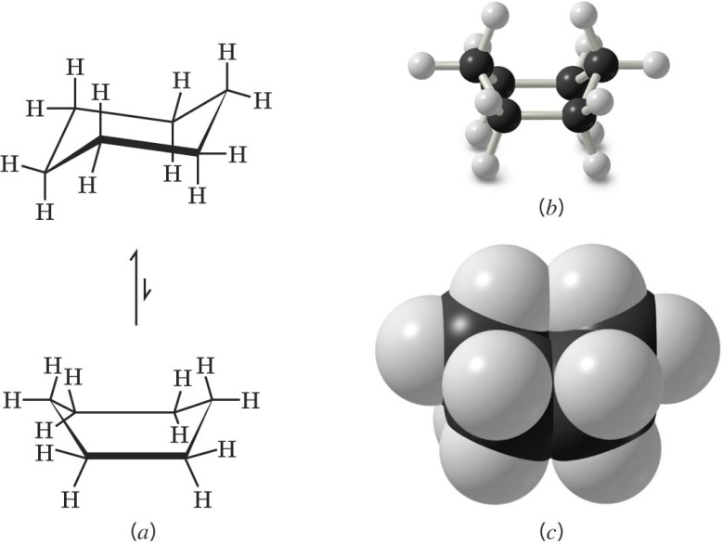
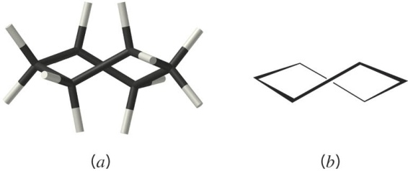
The boat conformation is less stable because of flagpole interactions and tortional strain along the bottom of the boat
The twist conformation is intermediate in stability between the boat and the chair conformation

Slide 30
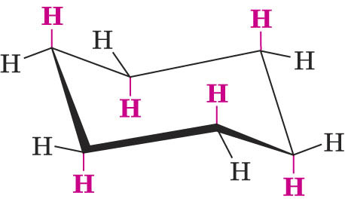
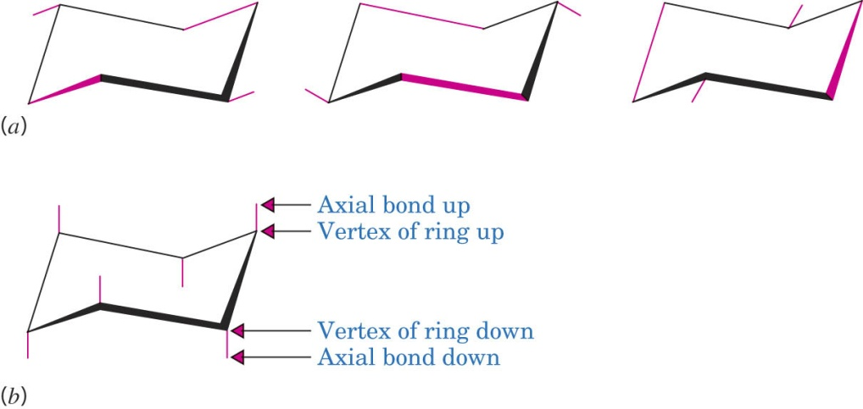
Substituted Cyclohexanes: Axial and Equatorial Hydrogen Atoms
Axial hydrogens are perpendicular to the average plane of the ring
Equatorial hydrogens lie around the perimeter of the ring
The C-C bonds and equatorial C-H bonds are all drawn in sets of parallel lines
The axial hydrogens are drawn straight up and down

Slide 31
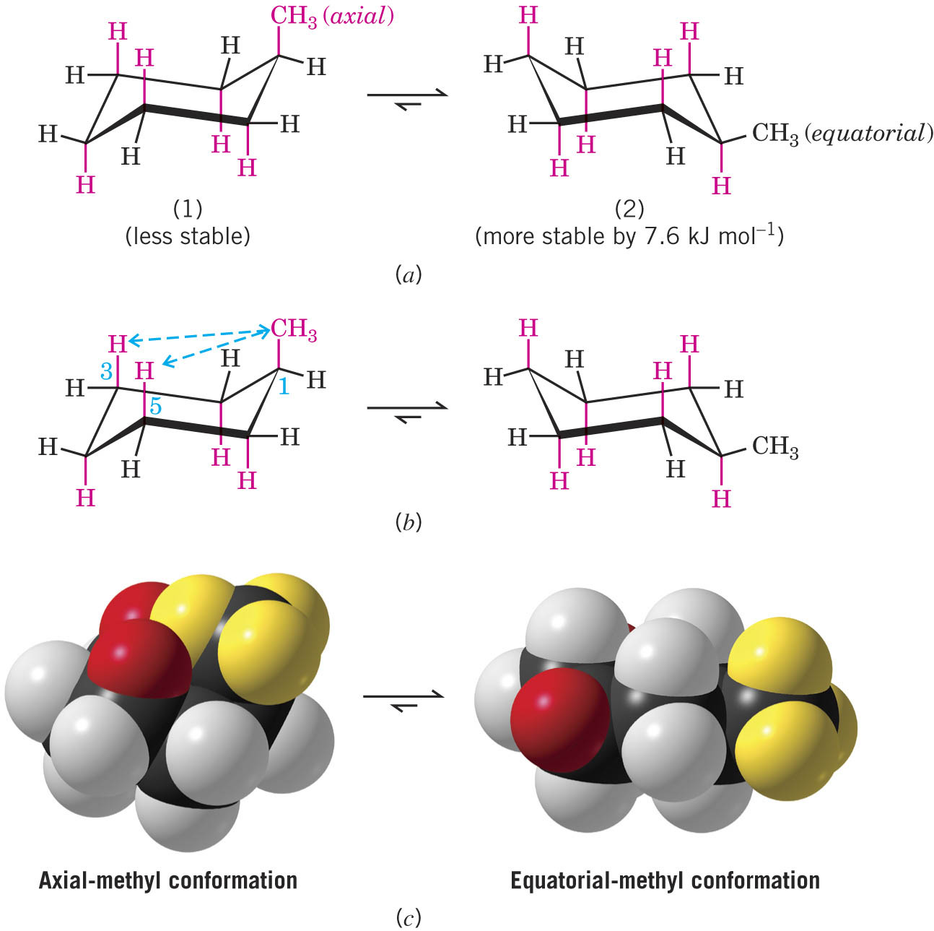
Methyl cyclohexane is more stable with the methyl equatorial
An axial methyl has an unfavorable 1,3-diaxial interaction with axial C-H bonds 2 carbons away
A 1,3-diaxial interaction is the equivalent of 2 gauche butane interactions

Slide 32
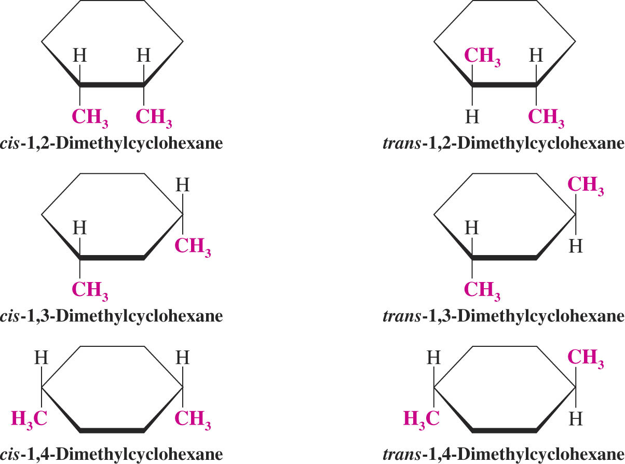
Disubstitued Cycloalkanes
Can exist as pairs of cis-trans stereoisomers
Cis: groups on same side of ring
Trans: groups on opposite side of ring

Slide 33
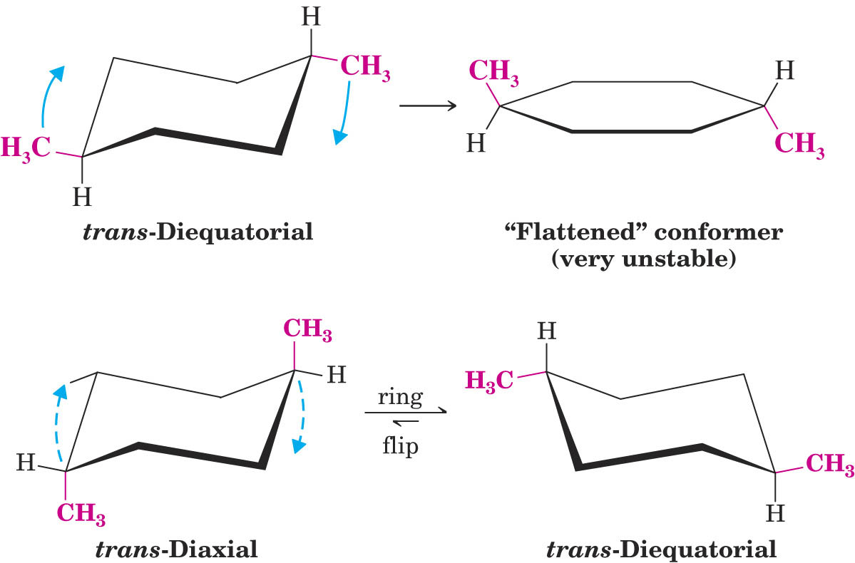
Trans-1,4-dimethylcylohexane prefers a trans-diequatorial conformation

Slide 34
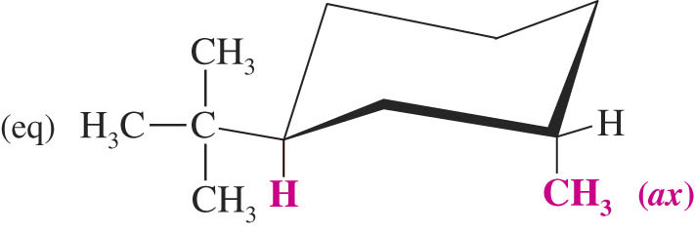
Cis-1,4-dimethylcyclohexane exists in an axial-equatorial conformation
A very large tert-butyl group is required to be in the more stable equatorial position

Slide 35
Synthesis of Alkanes and Cycloalkanes
Hydrogenation of Alkenes and Alkynes

Slide 36
Reduction of Alkyl Halides

Slide 37
Alkylation of Terminal Alkynes
Alkynes can be subsequently hydrogenated to alkanes

Slide 38
Retrosynthetic Analysis-Planning Organic Synthesis
The synthetic scheme is formulated working backward from the target molecule to a simple starting material
Often several schemes are possible

