Slide 1
Blood Basics

Slide 2
What the functions of the blood?
To convey food materials to the body cells and to remove waste products from them
To carry oxygen used in the oxidation of foods and to remove carbon dioxide resulting from such oxidation
To transport the initial secretions and vitamins which control the activities of the body
To aid in the control of pH, water content and temperature of the tissue
To assist the body’s defense against bacterial disease by means of antitoxins or by leucocytes which have the ability to destroy bacteria

Slide 3
What makes up our blood?
RED BLOOD CELLS (Erythrocytes) – The most abundant cells in our blood; they are produced in the bone marrow and contain a protein called hemoglobin that carries oxygen to our cells.
WHITE BLOOD CELLS (Leukocytes) – They are part of the immune system and destroy infectious agents called pathogens.
PLASMA – This is the yellowish liquid portion of blood that contains electrolytes, nutrients and vitamins, hormones, clotting factors, and proteins such as antibodies to fight infection.
PLATELETS (Thrombocytes) – The clotting factors that are carried in the plasma; they clot together in a process called coagulation to seal a wound and prevent a loss of blood.

Slide 4
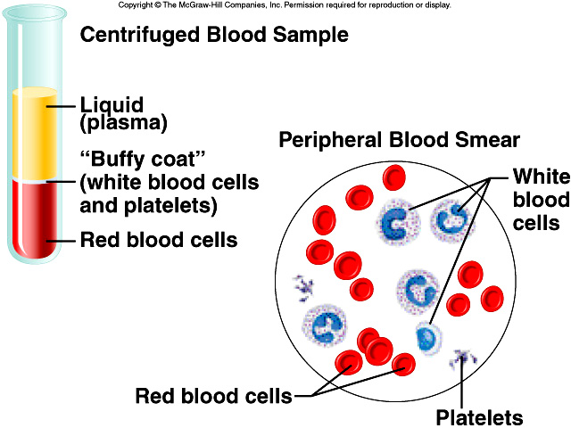

Slide 5
What makes up our blood?
RED BLOOD CELLS (Erythrocytes) – The most abundant cells in our blood; they are produced in the bone marrow and contain a protein called hemoglobin that carries oxygen to our cells.
Functions:
Transport oxygen from the lungs to the tissue and carbon dioxide from the tissue to the lungs
Assist in acid-base regulation by eliminating carbon dioxide in the lungs and by buffering action
Composition:
Heme – the red pigment
Globin - protein

Slide 6
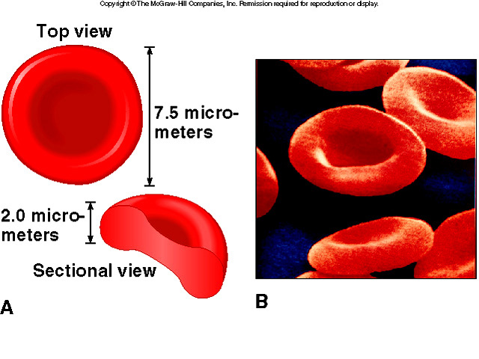

Slide 7
Disease associated with RBC
ANEMIA – condition in which the RBC or the % hemoglobin or both are below normal
Types
Primary Anemia or Pernicious Anemia – activity of blood building tissue is decreased (average life = 4 months)
Symptoms:
Abnormality in the shape of RBC
Lack of HCl in the gastric juice
Appearance of a very red tongue
Secondary Anemia – develops as a result of some other disturbance in the body
Condition where it develops:
severe hemorrhage, cancer and various types of infection and parasitism
c. Nutritional Anemia – results from lack of iron in the diet
LEUKEMIA – neoplastic disease arising from blood forming tissue

Slide 8
What makes up our blood?
WHITE BLOOD CELLS (Leukocytes) – They are part of the immune system and destroy infectious agents called pathogens.

Slide 9
What makes up our WBC?
a. Neutrophils
granulocyte
most numerous
phagocytic cells (lysosomes)
b. Eosinophils
granulocyte
1-3%
control inflammatory & allergic response
c. Basophils
granulocyte
least common
histamine (inflammatory) / heparin (prevents clots)

Slide 10
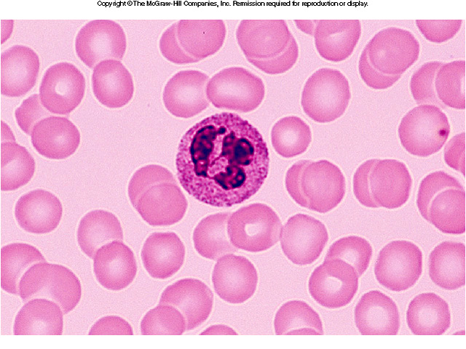

Slide 11
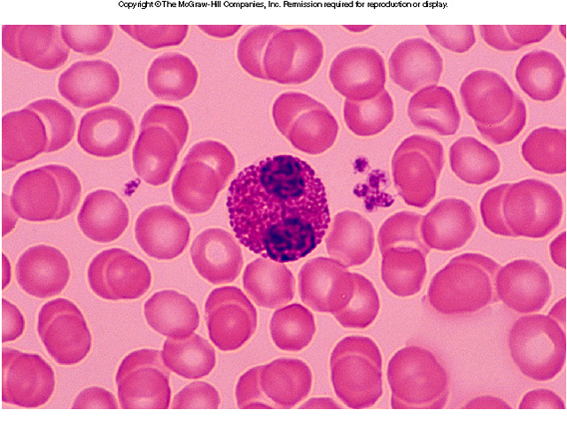

Slide 12
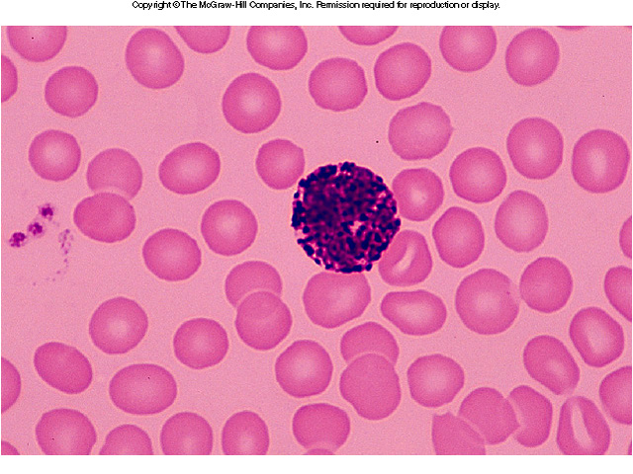

Slide 13
What makes up our WBC?
d. Monocytes
agranulocyte
largest WBC
after 3 days -> macrophages
phagocytes with lysosomes
ingests larger objects than Neutrophils
e. Lymphocytes
agranulocyte
cells of the immune system
B cells (antibodies) / T cells immune response

Slide 14
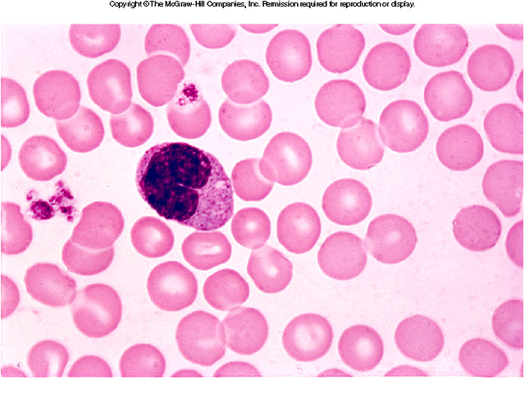

Slide 15
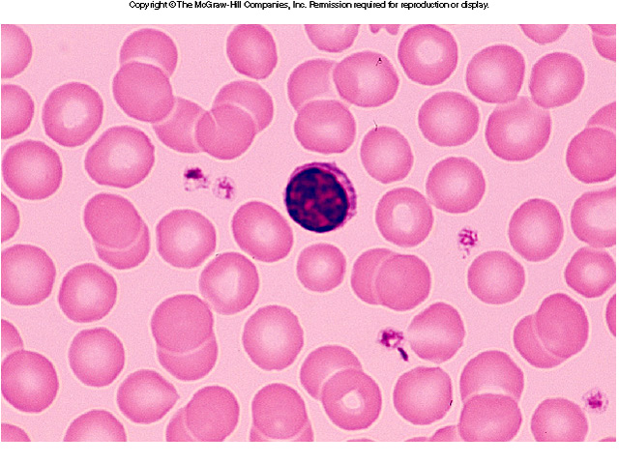

Slide 16
Disease associated with Leucocytes
Leucocytosis– increases leucocytes above normal range
Physiologic causes:
Strenous exercise, convulsive seizures, excitement, apprehension, fear and pain, digestion and pregnancy
Pathologic causes:
Infection, intoxication, tissue necrosis, acute hemorrhage and hemolysis
Leucopenia– leucocyte count is below normal
Infection
Bone marrow abnormalities
Chemical agents (analgesics, antibiotics

Slide 17
What makes up our blood?
PLASMA – This is the yellowish liquid portion of blood that contains electrolytes, nutrients and vitamins, hormones, clotting factors, and proteins such as antibodies to fight infection.
PLATELETS (Thrombocytes) – The clotting factors that are carried in the plasma; they clot together in a process called coagulation to seal a wound and prevent a loss of blood.

Slide 18
Thromboplastin w/ platelets & calcium
Prothrombin Thrombin
Thrombin acts on fibrinogen (in plasma)
fibrin threads
fibrin threads create mesh

Slide 19
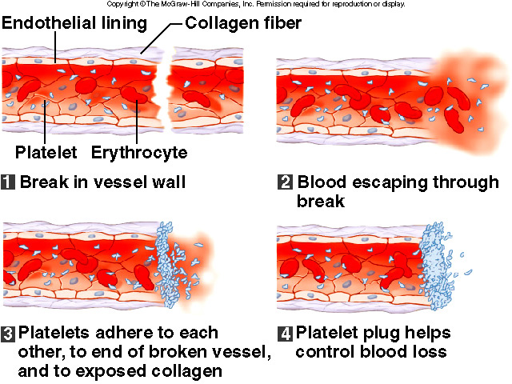
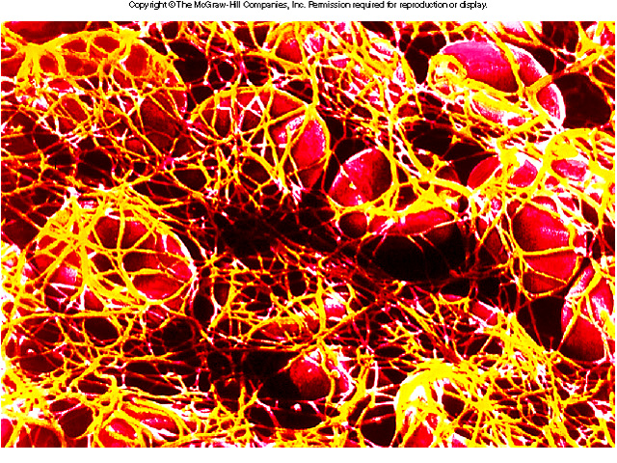

Slide 20
Disease associated with platelets
Thrombosis – intravascular clotting
Anticlotting agents : oxalates, citrates, heparin, hirudin
Hemophilia – clotting time of blood is increased or not at all caused by lack of thromplastin
Inherited from the female but appears only on male

Slide 21
Blood Facts
The average adult has about FIVE liters of blood inside of their body, which makes up 7-8% of their body weight.
Blood is living tissue that carries oxygen and nutrients to all parts of the body, and carries carbon dioxide and other waste products back to the lungs, kidneys and liver for disposal. It also fights against infection and helps heal wounds, so we can stay healthy.
There are about one billion red blood cells in two to three drops of blood. For every 600 red blood cells, there are about 40 platelets and one white cell.
http://www.bloodbankofalaska.org/about_blood/index.html

Slide 22
Genetics of Blood Types
Your blood type is established before you are BORN, by specific GENES inherited from your parents.
You inherit one gene from your MOTHER and one from your FATHER.
These genes determine your blood type by causing proteins called AGGLUTINOGENS to exist on the surface of all of your red blood cells.

Slide 23
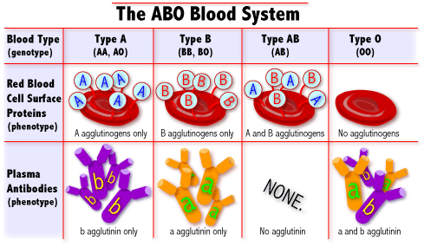
What are blood types?
Blood Types
AA or AO = Type A BB or BO = Type B OO = Type O AB = Type AB
There are 3 alleles or genes for blood type: A, B, & O. Since we have 2 genes, there are 6 possible combinations.
http://learn.genetics.utah.edu/units/basics/blood/types.cfm

Slide 24
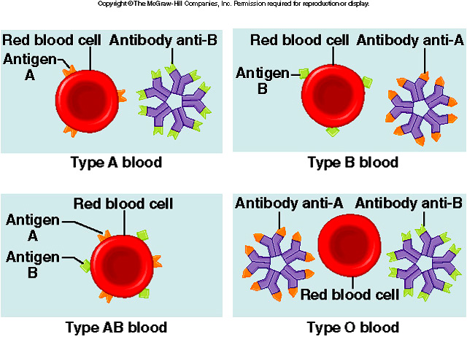

Slide 25
How common is your blood type?
46.1%
38.8%
11.1%
3.9%

Slide 26
Blood Transfusions
A blood transfusion is a procedure in which blood is given to a patient through an intravenous (IV) line in one of the blood vessels. Blood transfusions are done to replace blood lost during surgery or a serious injury. A transfusion also may be done if a person’s body can't make blood properly because of an illness.
Who can give you blood?
People with TYPE O blood are called Universal Donors, because they can give blood to any blood type.
People with TYPE AB blood are called Universal Recipients, because they can receive any blood type.
Rh + → Can receive + or -
Rh - → Can only receive -
Universal Donor
O
A
B
AB
Universal Recipient

Slide 27
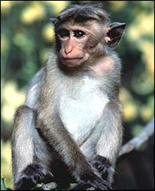
Rh Factors
Scientists sometimes study Rhesus monkeys to learn more about the human anatomy because there are certain similarities between the two species. While studying Rhesus monkeys, a certain blood protein was discovered. This protein is also present in the blood of some people. Other people, however, do not have the protein.
The presence of the protein, or lack of it, is referred to as the Rh (for Rhesus) factor.
If your blood does contain the protein, your blood is said to be Rh positive (Rh+). If your blood does not contain the protein, your blood is said to be Rh negative (Rh-).
A+ A- B+ B- AB+ AB- O+ O-
http://www.fi.edu/biosci/blood/rh.html

Slide 28
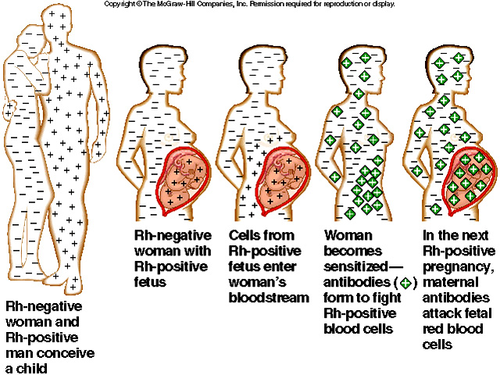

Slide 29
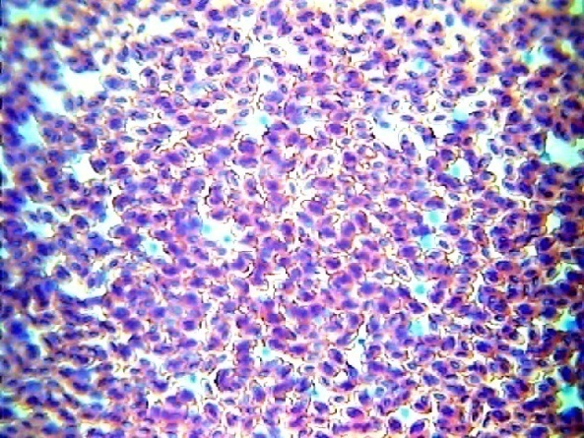
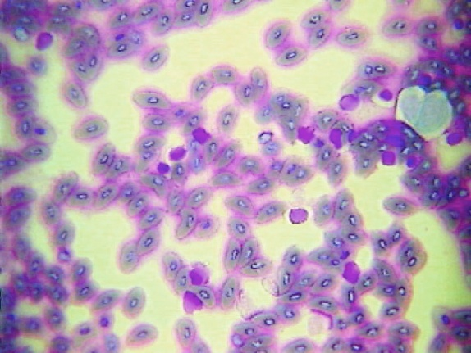
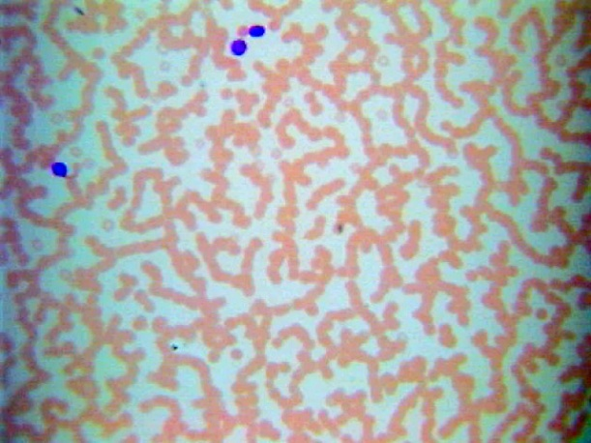
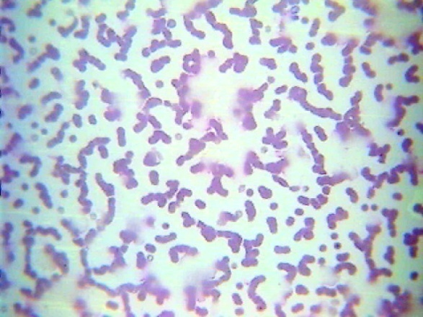
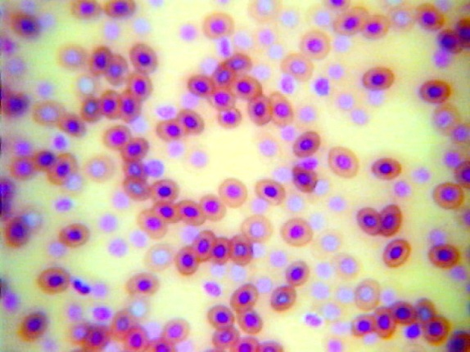
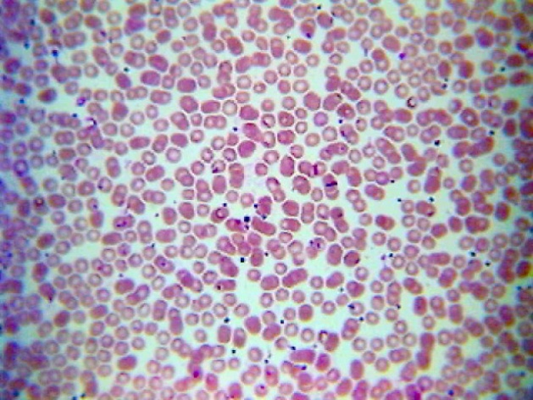
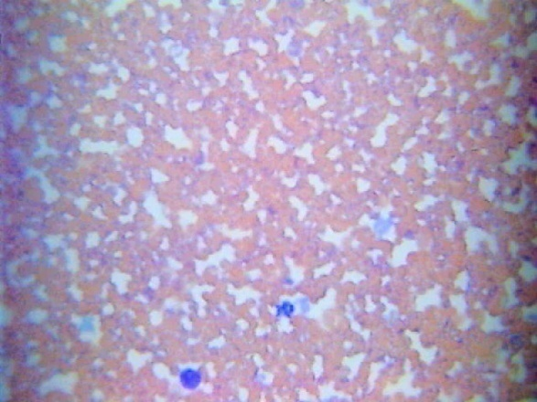
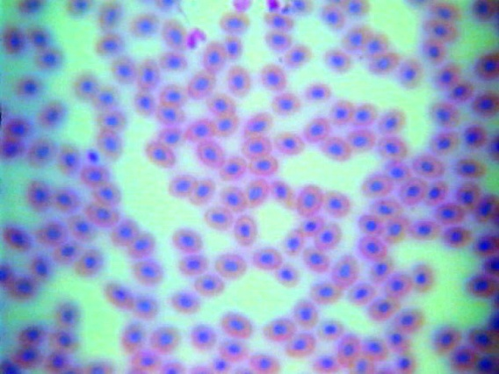
Microscopic Views
Bird Blood
Fish Blood
Horse Blood
Cat Blood
Frog Blood
Human Blood
Dog Blood
Snake Blood

