Slide 1
DIETARY MINERALS

Slide 2
Microminerals : An Overview
􀂄 Inorganic atoms or molecules
􀂄 Microminerals or trace elements
􀂄 < 100 mg/day needed

Slide 3
Bioavailability & Regulation of
Trace Minerals
Bioavailability influenced by:
  Genetics
  Nutritional status
  Nutrient interactions
  Aging
Absorbed in small intestine
Circulated in blood
Deficiencies & toxicities rare
  Except genetic disorders & environmental exposure

Slide 4
Functions of Trace Minerals in the Body
Cofactors
  Metalloenzyme
Components of nonenzymatic molecules
Provide structure to mineralized tissues

Slide 5
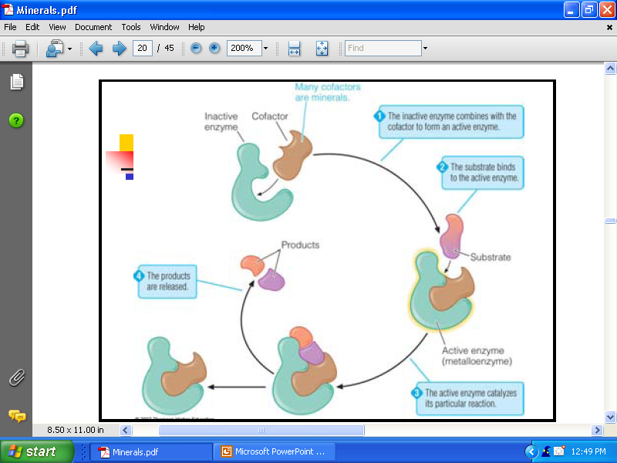

Slide 6

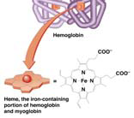
Iron ( Fe )
RDA
  Male 10 mg
  Female 18 mg
Total body Iron 4—5 grams

Slide 7
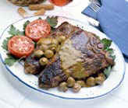
Dietary Sources
Animal Sources
  Meat, liver, kidney, egg yolk, fish
Plant Sources
  Green leafy vegetables, spinach, nuts, dates, beans

Slide 8
Iron in the Body
70% of iron in body is functional; found
in enzymes and other molecules
  􀂄 >80% of this found in red blood cells
30% of iron is in storage depots or
transport proteins
Iron absorption, transport, storage and
loss is highly regulated

Slide 9
Distribution of Iron in Body
Functional Iron
Hb 900 grams contains 3 grams of iron
Mb 40 grams contains 0.13 grams of iron
Enzymes 10—20 grams contains 0.04– 0.08 grams of iron
Storage iron
Transferrin contains 0.04 grams of iron
Ferritin contains 0.4– 0.8 grams of iron

Slide 10
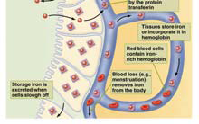
Iron Absorption
If body needs more
iron, it increases
amount of “transferrin”
an iron carrying protein.
Iron can also be stored
in another protein called
“ferritin

Slide 11
Iron Absorption
Transport across
  􀂄 Brush border
  􀂄 Basolateral membrane
Heme iron
  􀂄 Chemical modification not needed
Nonheme iron
  􀂄 Reduced to ferrous form
Ferritin

Slide 12
Absorption, cont.
Iron from animal sources much better absorbed than
that from plant sources
Absorption of iron from plant sources increased by
  􀂄 Vitamin C
  􀂄 Meat in diet
Absorption is decreased by
  􀂄 Phytates (grain products)
  􀂄 Polyphenols (tea, coffee)
  􀂄 Other minerals (calcium, zinc)

Slide 13
Effect of Iron Status on Iron
Absorption
Iron deficiency
  􀂄 Increases production of transport proteins
  􀂄 Decreases ferritin production
Adequate or excess iron
  􀂄 Decreases production of transport proteins

Slide 14
Iron Circulation, Uptake Into
Cells, & Storage
Iron storage compounds in liver, bone marrow, and spleen
  Ferritin
    􀂄 Main storage form
  Hemosiderin
    􀂄 Long-term storage

Slide 15
Bioavailability of Iron
Influenced by:
Form
  􀂄 Heme > Ferrous > Ferric
Iron status
Presence/absence of other dietary
components
Only 10 % of dietary iron is absorbed

Slide 16
Excretion of iron
Mostly in feces
Small amount in sweat
Very small amount in urine
Average excretion
  < I mg/ day in males
  1.5 –2 mg /day in females
In nephrotic syndrome excretion increases

Slide 17
Functions of Iron
􀂄 Oxygen transport: hemoglobin
􀂄 Iron reservoir: myoglobin
􀂄 Cellular energy metabolism

Slide 18
Functions of iron
Oxygen transport via hemoglobin
  􀂄 Thus, necessary for ATP production!
Essential component of many enzymes
Immune function
Brain function
  Iron deficiency/ toxicity thought to slow mental development in kids

Slide 19
Oxygen Transport: Hemoglobin
􀂄 Most abundant
protein in red blood
cells
􀂄 4 protein subunits +
4 iron-containing
heme groups
􀂄 Delivers oxygen to
cells
􀂄 Picks up carbon
dioxide

Slide 20
Iron Reservoir: Myoglobin
􀂄 Found in muscle cells
􀂄 Heme group + protein subunit
􀂄 Releases oxygen to cells when needed
for:
  􀂄 ATP production
  􀂄 Muscle contraction

Slide 21
Cellular Energy Metabolism
􀂄 Cytochromes
  􀂄 Heme-containing complexes
  􀂄 Function in electron transport chain
  􀂄 Allow conversion of ADP to ATP
􀂄 Iron as cofactor
  􀂄 Electron transport chain
  􀂄 Citric acid cycle
  􀂄 Gluconeogensis

Slide 22
Other Roles of Iron
Cytochrome P450 enzymes
Cofactor for antioxidant enzymes
  􀂄 Protects DNA, cell membranes, proteins
Cofactor for enzyme to make DNA

Slide 23
Iron Deficiency
Most common nutritional deficiency
At-risk groups
  􀂄 Infants, growing children, pregnant women

Slide 24
Mild Iron Deficiency
􀂄 Signs
  􀂄 Fatigue
  􀂄 Impaired physical work performance
  􀂄 Behavioral abnormalities
  􀂄 Impaired intellectual abilities in children
  􀂄 Body temperature regulation
  􀂄 Influences immune system

Slide 25
Severe Iron Deficiency: Iron-
Deficiency Anemia
􀂄 Microcytic hypochromic anemia
  􀂄 Small, pale red blood cells
  􀂄 Inability to produce enough heme
  􀂄 Decreased ability to carry oxygen
  􀂄 Decreased ATP synthesis
􀂄 Infants, children, pregnant and lactating
  women most at risk.

Slide 26
Iron Toxicity
Excess deposited in liver, heart,
muscles
Most common cause of childhood
poisoning
Symptoms
  Vomiting, diarrhea, constipation, black
stools
  Death
􀂄

Slide 27
Iron Toxicity
Hemosiderosis
  Microscopically visible form is hemosiderosis
  Iron overload without tissue injury
Hemochromatosis
  Macroscopically visible form
  Iron overload with tissue injury
  Bronze diabetes
    Bronze pigmentation of skin and tissues

Slide 28
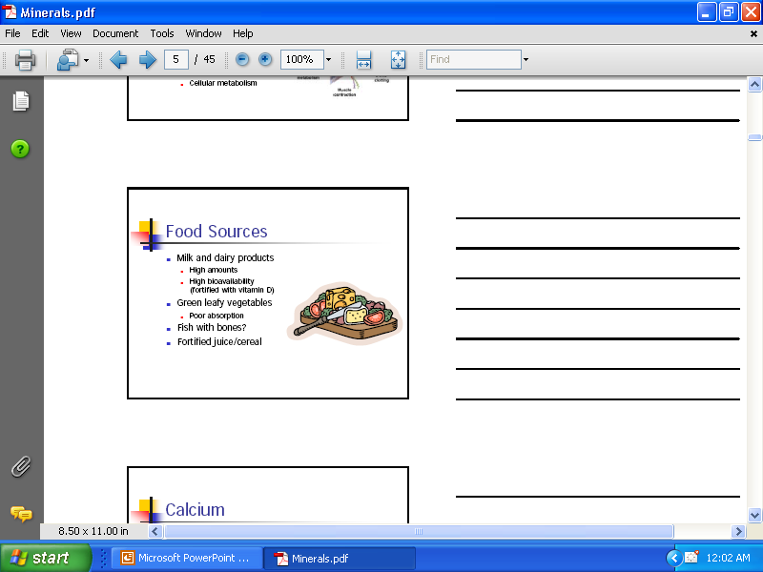
Copper ( Cu )
Dietary sources
  Oyster
  Nuts
  Legumes
  Mushrooms
  Meat
  Dry fruit
  Potatoes

Slide 29
Absorption, Metabolism, &
Regulation of Copper
Absorbed in small intestine & stomach as free and bound Cu
Amino acids bound Cu is also absorbable
Influenced by Cu status
  Body stores and requirement
  Form : Cupric or Cuprous
Excess incorporated into bile &
eliminated in feces

Slide 30
Absorption, Metabolism, &
Regulation of Copper
Bioavailability decreases with
  Antacids
  Iron
  Ca
  Zn

Slide 31
Transport of Cu
Ceruloplasmin 96 %
Remaining with albumin and globulin
Functions of ceruloplasmin
  Cu transport
  Conversion of iron from ferrous to ferric form

Slide 32
Functions of Copper
Needed to absorb and utilize iron
Part of anti oxidant enzyme superoxidase dimutase
ATP synthesis
  Cytochrome C oxidase
Connective tissue synthesis

Slide 33
Excretion
Unabsorbed in feces
Bile
Sweat
Urine
Menstrual blood

Slide 34
Copper Deficiency & Toxicity
Deficiency
  􀂄 Hospitalized patients & preterm infants
  􀂄 Antacids
Signs & Symptoms
  􀂄 Defective connective tissue, anemia, neural
  problems
􀂄 Toxicity
  􀂄 Rare

Slide 35
Copper Deficiency
Menke’s Disease
  X-linked recessive genetic disorder
  Poor copper absorption
  Steely hair syndrome
  Growth retardation

Slide 36
Copper Deficiency
Wilson’s disease
  Autosomal recessive disorder
  Increased Cu absorption
  Liver Cu level increases
  Excessive urinary excretion of Cu
  Serum Cu level decreases
  Cu accumulates in liver , brain and kidney
  CNS lesions with muscular incoordination

Slide 37

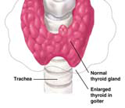
Iodine

Slide 38
Iodine
Essential for the formation of thyroid hormones
Total iodine content 20—40 mg ( 20 % in thyroid gland)
Plasma iodide level 0.3—0.5 micro gm/ dl
Daily intake 500 micro gm
Almost all absorbed
Remaining excreted in urine

Slide 39
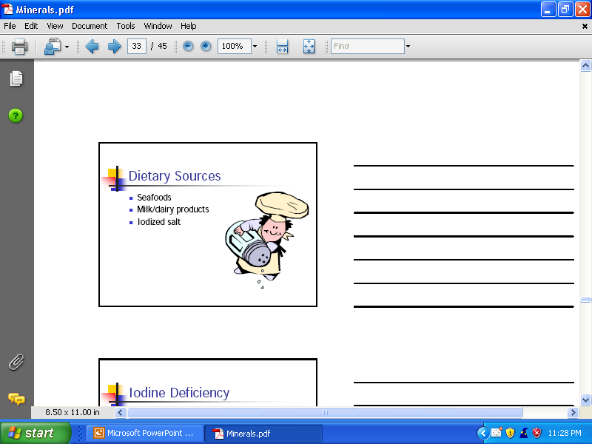
Dietary Sources
Seafood
Milk/dairy products
Iodized salt
Cod liver oil

Slide 40
Absorption, Metabolism, &Regulation of Iodine
Absorbed in small intestine & stomach
Also absorbed in lungs, mucous membrane and skin
Taken up by thyroid gland
Thyroid-stimulating hormone regulates
uptake

Slide 42
Functions of Iodine
Component of:
  􀂄 Thyroxine (T4)
  􀂄 Triiodothyronine (T3)
Regulates energy metabolism, growth, development
Signs of deficiency
  􀂄 Severe fatigue
  􀂄 Lethargy

Slide 43
Iodine Deficiency
Goiter (less severe)
  􀂄 Enlarged thyroid gland due to body’s attempt to increase thyroid hormone production

Slide 44
Iodine Deficiency
Cretinism (more severe)
  􀂄 Severe iodine deficiency during pregnancy, serious problems in baby
  􀂄 Stunted growth, deaf, mute, mentally retarded

Slide 45
Iodine Toxicity
􀂄 Hypothyroidism
􀂄 Hyperthyroidism ( Thyrotoxicosis )
􀂄 Formation of goiters

