Slide 1
Chapter 7 Alkenes and Alkynes I: Properties and Synthesis Elimination Reactions of Alkyl Halides

Slide 2
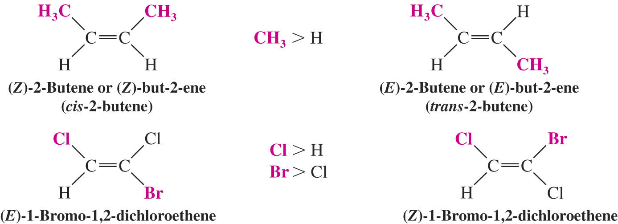
The (E)-(Z) System for Designating Alkene Diastereomers
The Cahn-Ingold-Prelog convention is used to assign the groups of highest priority on each carbon
If the group of highest priority on one carbon is on the same side as the group of highest priority on the other carbon the double bond is Z (zusammen)
If the highest priority groups are on opposite sides the alkene is E (entgegen)

Slide 3
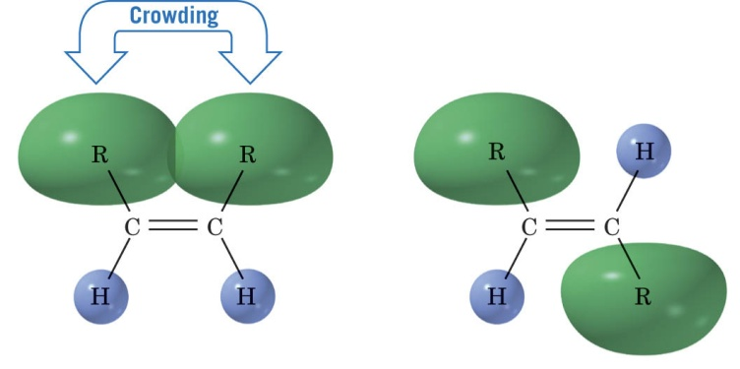
Relative Stabilities of Alkenes
Generally cis alkenes are less stable than trans alkenes because of steric hinderance
Heat of Hydrogenation
The relative stabilities of alkenes can be measured using the exothermic heats of hydrogenation
The same alkane product must be obtained to get accurate results

Slide 4
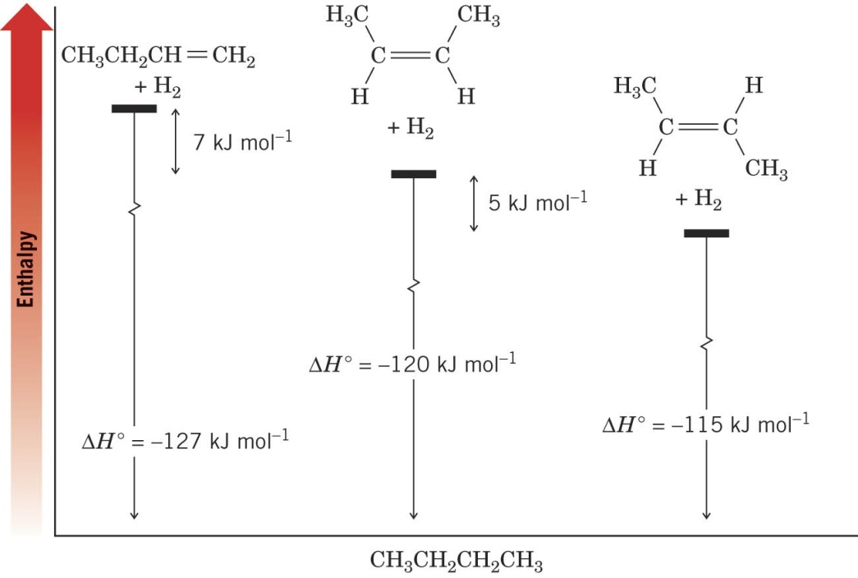
Heats of hydrogenation of three butene isomers:
Overall Relative Stabilities of Alkenes
The greater the number of attached alkyl groups (i.e. the more highly substituted the carbon atoms of the double bond), the greater the alkene’s stability

Slide 5
Synthesis of Alkenes via Elimination Reactions
Dehydrohalogenation
Reactions by an E2 mechanism are most useful
E1 reactions can be problematic
E2 reaction are favored by:
Secondary or tertiary alkyl halides
Alkoxide bases such as sodium ethoxide or potassium tert-butoxide
Bulky bases such as potassium tert-butoxide should be used for E2 reactions of primary alkyl halides

Slide 6
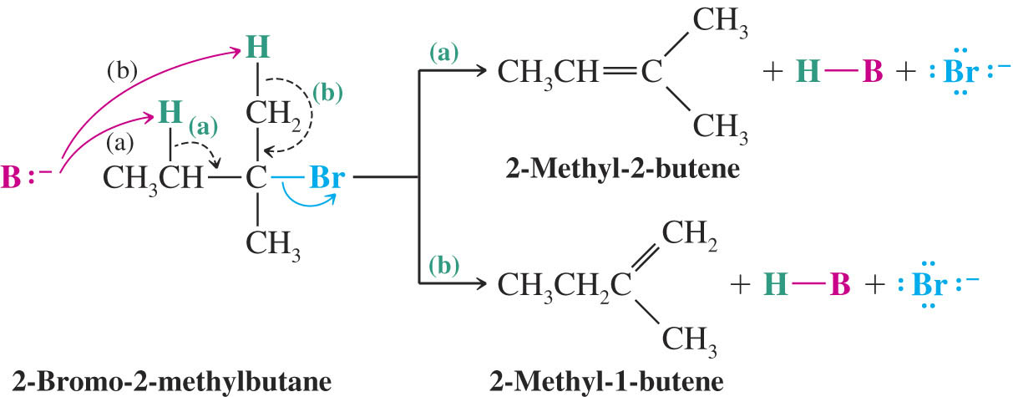
Zaitsev’s Rule: Formation of the Most Substituted Alkene is Favored with a Small Base
Some hydrogen halides can eliminate to give two different alkene products
Zaitzev’s Rule: when two different alkene products are possible in an elimination, the most highly substituted (most stable) alkene will be the major product
This is true only if a small base such as ethoxide is used

Slide 7
Formation of the Least Substituted Alkene Using a Bulky Base
Bulky bases such as potassium tert-butoxide have difficulty removing sterically hindered hydrogens and generally only react with more accessible hydrogens (e.g. primary hydrogens)

Slide 8
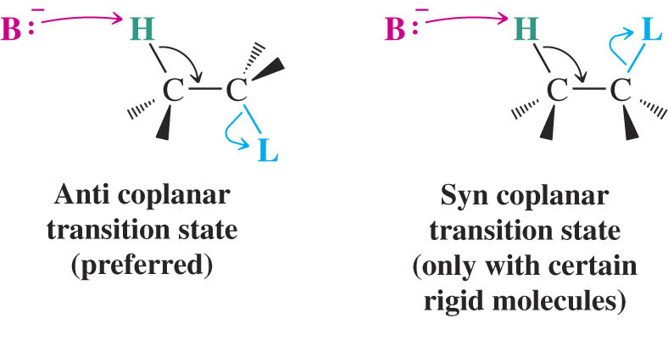
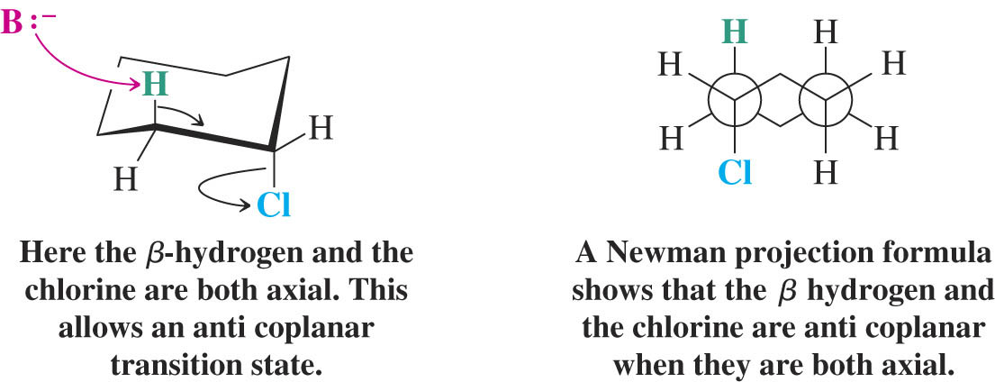
The Stereochemistry of E2 Reactions: The Orientation of Groups in the Transition State
All four atoms involved must be in the same plane
Anti coplanar orientation is preferred because all atoms are staggered
In a cyclohexane ring the eliminating substituents must be diaxial to be anti coplanar

Slide 9
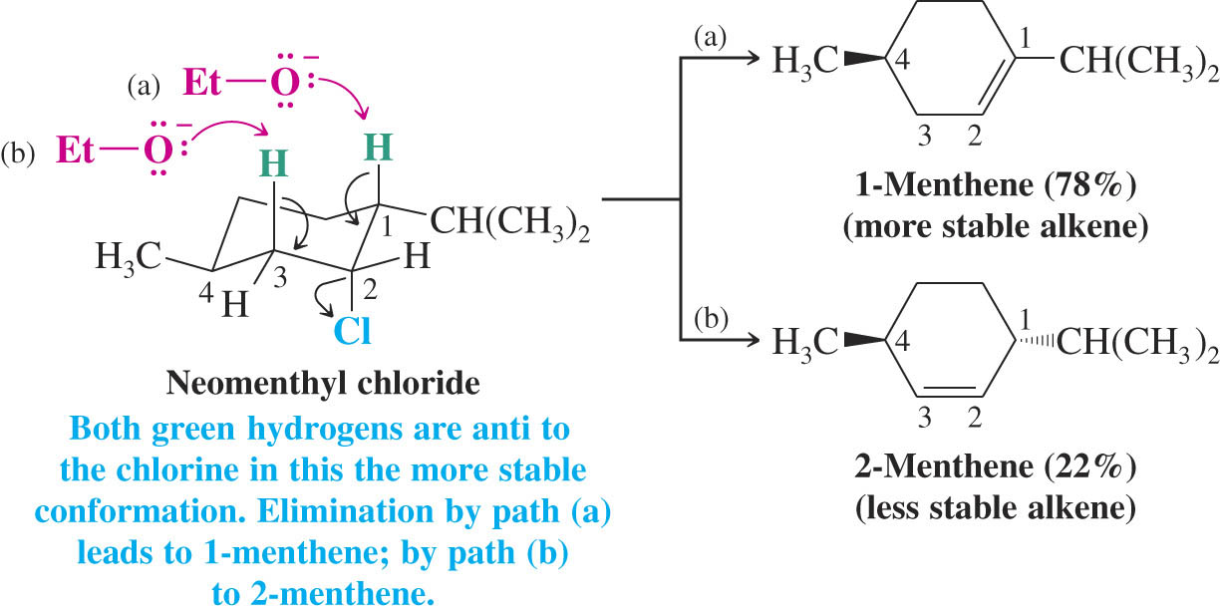
Neomenthyl chloride and menthyl chloride give different elimination products because of this requirement
In neomenthyl chloride, the chloride is in the axial position in the most stable conformation
Two axial hydrogens anti to chlorine can eliminate; the Zaitzev product is major

Slide 10
In menthyl chloride the molecule must first change to a less stable conformer to produce an axial chloride
Elimination is slow and can yield only the least substituted (Hoffman) product from anti elimination

Slide 11
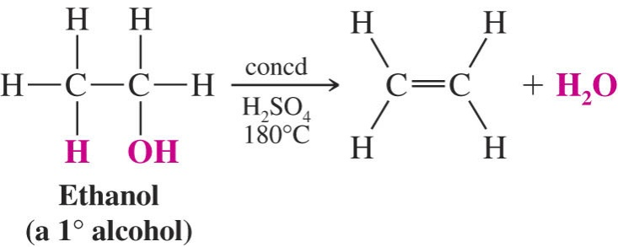
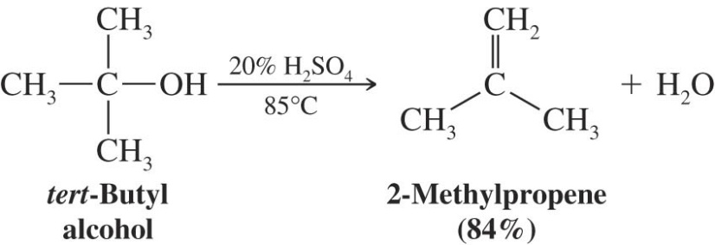
Acid Catalyzed Dehydration of Alcohols
Recall that elimination is favored over substitution at higher temperatures
Typical acids used in dehydration are sulfuric acid and phosphoric acid
The temperature and concentration of acid required to dehydrate depends on the structure of the alcohol
Primary alcohols are most difficult to dehydrate, tertiary are the easiest
Rearrangements of the carbon skeleton can occur

Slide 12
Mechanism for Dehydration of Secondary and Tertiary Alcohols: An E1 Reaction
Only a catalytic amount of acid is required since it is regenerated in the final step of the reaction

Slide 13
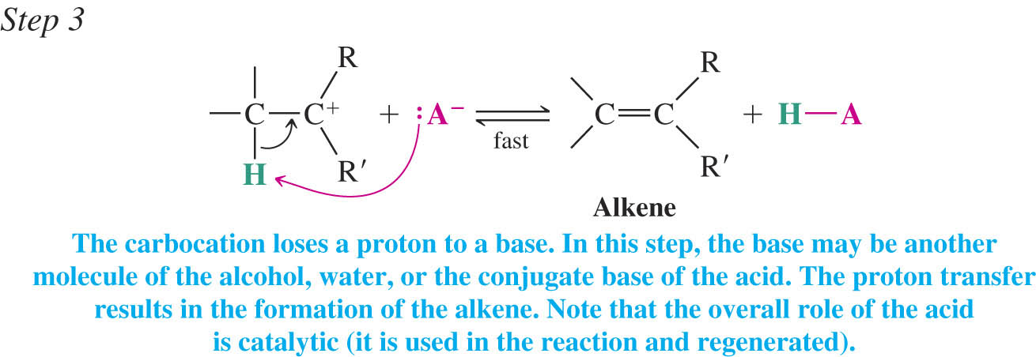
Carbocation Stability and the Transition State
Recall the stability of carbocations is:
The second step of the E1 mechanism in which the carbocation forms is rate determining
The transition state for this reaction has carbocation character
Tertiary alcohols react the fastest because they have the most stable tertiary carbocation-like transition state in the second step

Slide 14
A Mechanism for Dehydration of Primary Alcohols: An E2 Reaction
Primary alcohols cannot undergo E1 dehydration because of the instability of the carbocation-like transition state in the 2nd step
In the E2 dehydration the first step is again protonation of the hydroxyl to yield the good leaving group water

Slide 15
Carbocation Stability and the Occurrence of Molecular Rearrangements
Rearrangements During Dehydration of Secondary Alcohols
Rearrangements of carbocations occur if a more stable carbocation can be obtained
Example
The first two steps are to same as for any E1 dehydration

Slide 16
In the third step the less stable 2º carbocation rearranges by shift of a methyl group with its electrons (a methanide)
This is called a 1,2 shift
The removal of a proton to form the alkene occurs to give the Zaitzev (most substituted) product as the major one

Slide 17
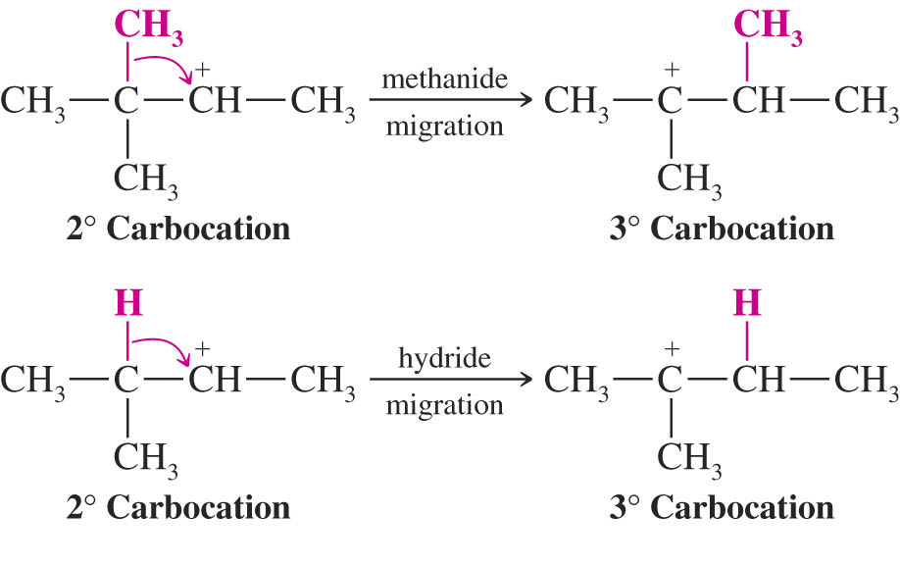
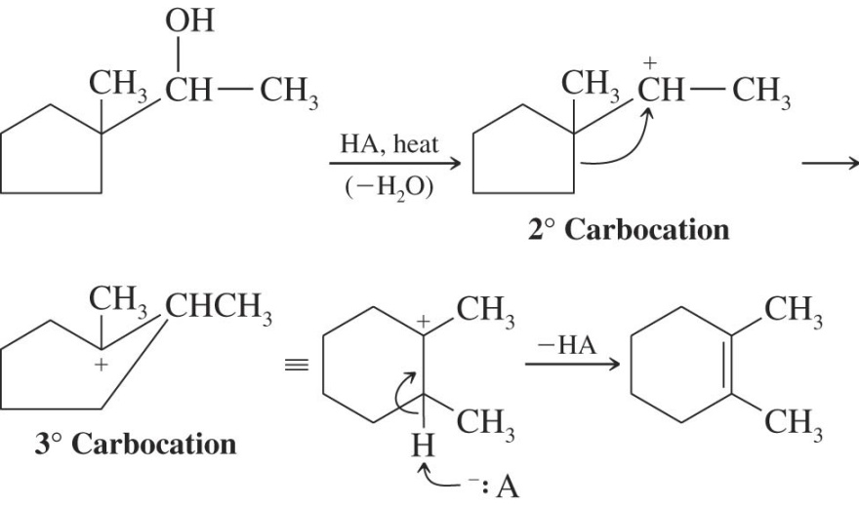
A hydride shift (migration of a hydrogen with its electrons) can also occur to yield the most stable carbocation
Carbocation rearrangements can lead to formation of different ring sizes

Slide 18
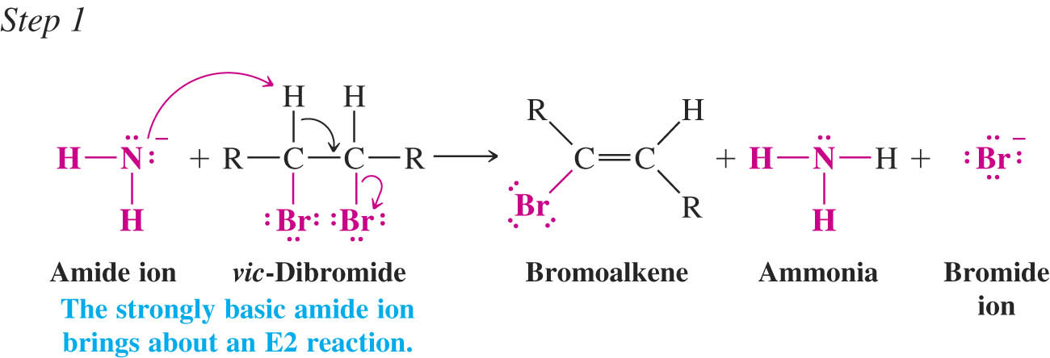
Synthesis of Alkynes by Elimination Reactions
Alkynes can be obtained by two consecutive dehydrohalogenation reactions of a vicinal dihalide

Slide 19
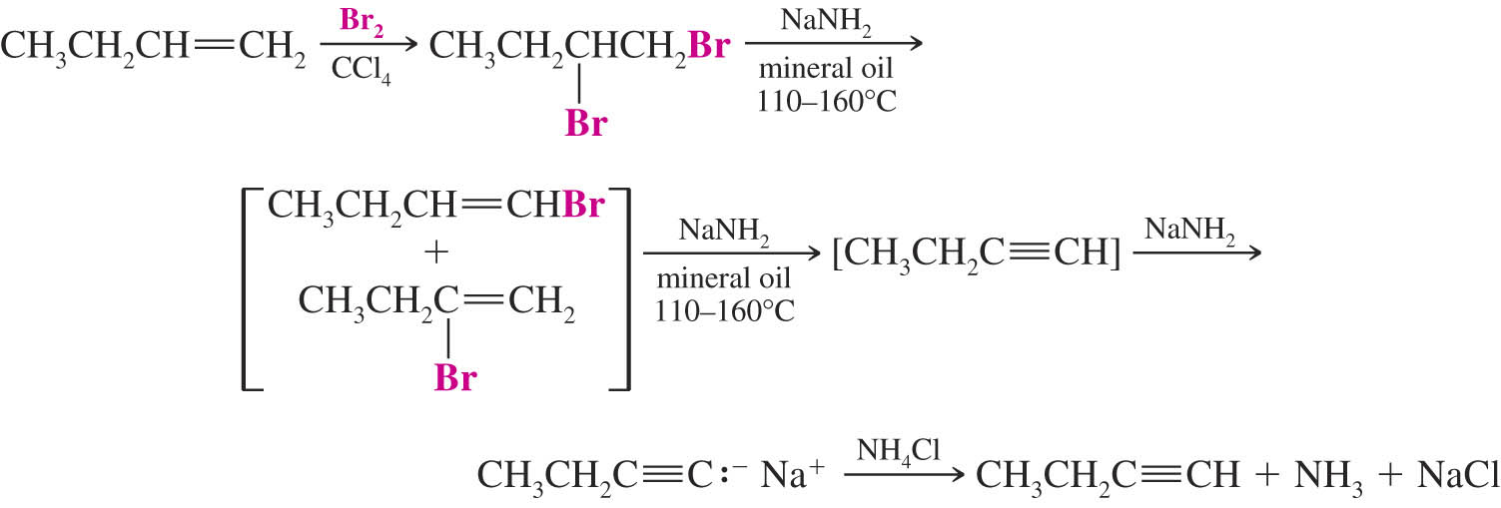
Alkenes can be converted to alkynes by bromination and two consecutive dehydrohalogenation reactions
Geminal dihalides can also undergo consecutive dehydrohalogenation reactions to yield the alkyne

Slide 20
The Acidity of Terminal Alkynes
Recall that acetylenic hydrogens have a pKa of about 25 and are much more acidic than most other C-H bonds
The relative acidity of acetylenic hydrogens in solution is:
Acetylenic hydrogens can be deprotonated with relatively strong bases (sodium amide is typical)
The products are called alkynides

Slide 21
Replacement of the Acetylenic Hydrogen Atom of Terminal Alkynes
Sodium alkynides can be used as nucleophiles in S_{N}2 reactions
New carbon-carbon bonds are the result
Only primary alkyl halides can be used or else elimination reactions predominate

Slide 22
Hydrogenation of Alkenes
Hydrogen adds to alkenes in the presence of metal catalysts
Heterogeneous catalysts: finely divided insoluble platinum, palladium or nickel catalysts
Homogeneous catalysts: catalyst(typically rhodium or ruthenium based) is soluble in the reaction medium
Wilkinson’s catalyst is Rh[(C₆H₅)₃P]₃Cl
This process is called a reduction or hydrogenation
An unsaturated compound becomes a saturated (with hydrogen) compound

Slide 23
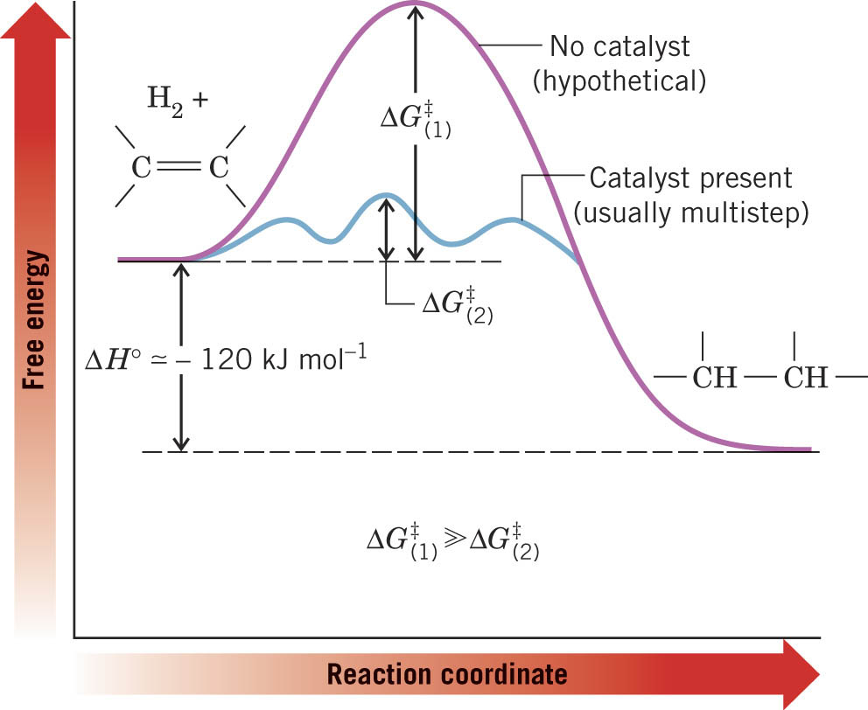
Hydrogenation: The Function of the Catalyst
The catalyst provides a new reaction pathway with lower ΔG‡ values

Slide 24
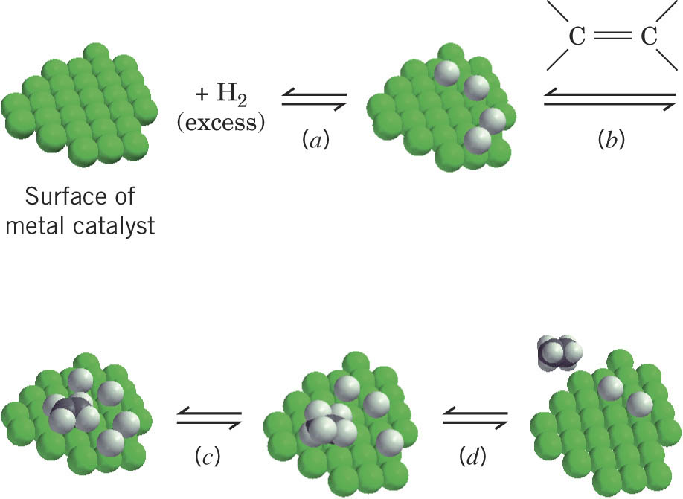
In heterogeneous catalysis the hydrogen and alkene adsorb to the catalyst surface and then a step-wise formation of C-H bonds occurs
Both hydrogens add to the same face of the alkene (a syn addition)
Addition to opposite faces of the double bond is called anti addition

Slide 25
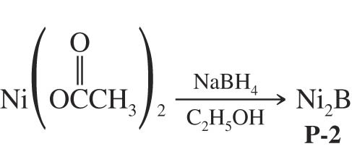
Hydrogenation of Alkynes
Reaction of hydrogen using regular metal catalysts results in formation of the alkane
Syn Addition of Hydrogen: Synthesis of cis-Alkenes
The P-2 catalyst nickel boride results in syn addition of one equivalent of hydrogen to a triple bond
An internal alkyne will yield a cis double bond

Slide 26
Lindlar’s catalyst also produces cis-alkenes from alkynes
Anti Addition of Hydrogen: Synthesis of trans-Alkenes
A dissolving metal reaction which uses lithium or sodium metal in low temperature ammonia or amine solvent produces trans-alkenes
Net anti addition occurs by formal addition of hydrogen to the opposite faces of the double bond

Slide 27
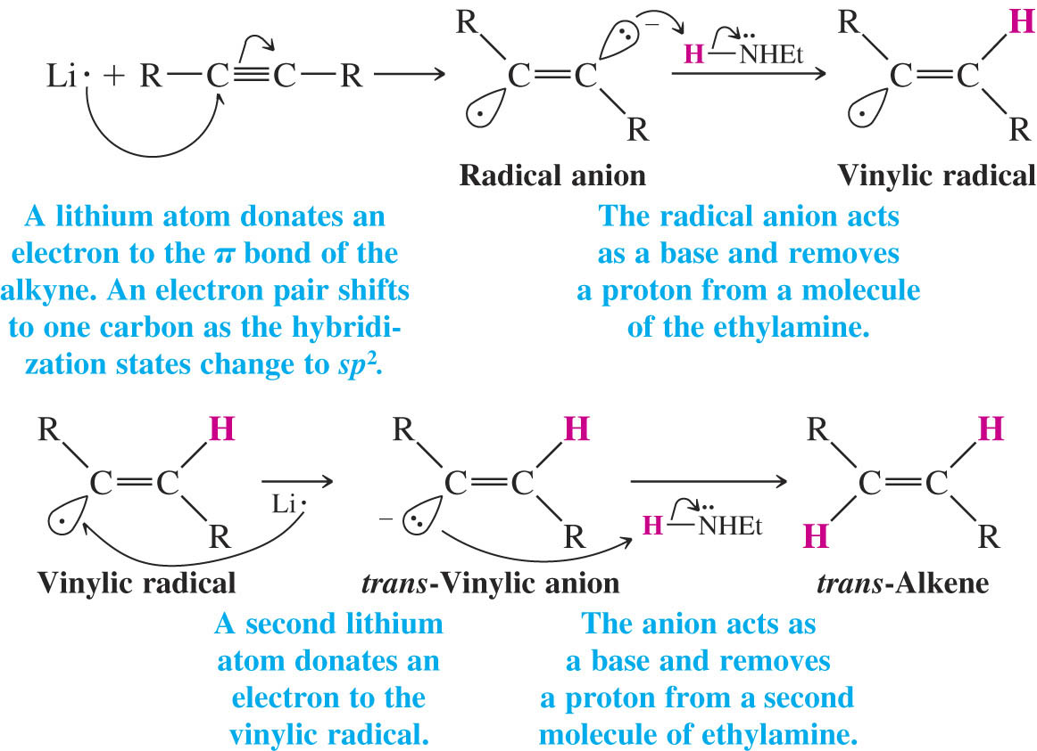
The mechanism is a free radical reaction with two electron transfer reactions from the metal
The vinylic anion prefers to be trans and this determines the trans stereochemistry of the product

