Slide 1


Slide 2
VITAMINS
Notes:
Vitamins do not provide energy but they facilitate the release of energy from MACRONUTRIENTS.
Vitamins can function only when intact, since they are complex organic molecules (contain carbon), they are vulnerable to destruction by heat, light and chemical agents

Slide 3
Types
Water Soluble
  Vit C and B Vitamins
Fat Soluble
  Vit A, D, E and K
Notes:
There are two types of vitamins: fat soluble and water soluble.
When you eat foods that contain fat-soluble vitamins, the vitamins are stored in the fat tissues in your body and in your liver. They wait around in your body fat until your body needs them.
Fat-soluble vitamins are happy to stay stored in your body for awhile — some stay for a few days, some for up to 6 months! Then, when it's time for them to be used, special carriers in your body take them to where they're needed. Vitamins A, D, E, and K are all fat-soluble vitamins.
Water-soluble vitamins are different. When you eat foods that have water-soluble vitamins, the vitamins don't get stored as much in your body. Instead, they travel through your bloodstream. Whatever your body doesn't use comes out when you urinate (pee).
So these kinds of vitamins need to be replaced often because they don't stick around! This crowd of vitamins includes vitamin C and the big group of B vitamins — B1 (thiamin), B2 (riboflavin), niacin, B6 (pyridoxine), folic acid, B12 (cobalamine), biotin, and pantothenic acid.

Slide 4
ABSORPTION
Water-Soluble
Directly into the blood
Fat Soluble
First into the lymph, then the blood
Notes:
Differences between water soluble and fat soluble vitamins in terms of

Slide 5
TRANSPORT
Water-Soluble
Travel Freely
Fat Soluble
Many require protein carriers

Slide 6
STORAGE
Water-Soluble
Circulates freely in water-filled parts of the body
Fat Soluble
Stored in the cells associated with fats

Slide 7
EXCRETION
Water-Soluble
Kidneys detect and remove excess in urine
Fat Soluble
Less readily excreted; tend to remain in fat-storage sites
Notes:
Fat soluble vitamins has more potential for reaching LEVELS OF TOXICITY in the body

Slide 8
TOXICITY
Water-Soluble
Possible to reach toxic levels when consumed from supplements
Fat Soluble
Likely to reach toxic levels when consumed from supplements

Slide 9
REQUIREMENTS
Water-Soluble
Needed in frequent doses (1 to 3 days)
Fat Soluble
Needed in periodic doses (weeks to months)

Slide 10
Water Soluble Vitamins

Slide 11
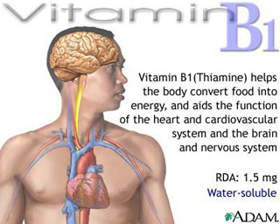
Notes:
Thiamine
Definition:
Thiamine is one of the B vitamins, a group of water-soluble vitamins that participate in many of the chemical reactions in the body.
Alternative Names:
Vitamin B-1
Function:
Thiamine (vitamin B-1) helps the body cells convert carbohydrates into energy.
It is also essential for the functioning of the heart, muscles, and nervous system.

Slide 12
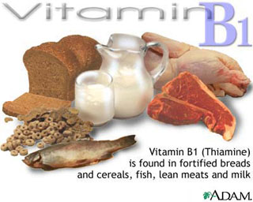
Notes:
Sources:
Whole-grain
Easily destroyed by heat
Deficiency Disease:
BERIBERI (wet – with edema; dry – with muscle wasting)
Beri – weakness
Beriberi – “I can’t, I can’t”

Slide 13
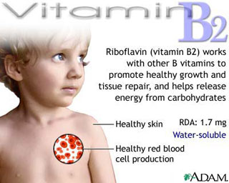
Notes:
Riboflavin
Alternative Names:
Vitamin B-2 (riboflavin)
Function:
Riboflavin (vitamin B-2) works with the other B vitamins.
It is important for body growth and red blood cell production and helps in releasing energy from carbohydrates.

Slide 14
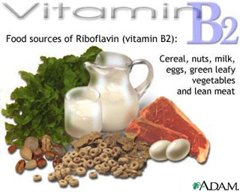
Notes:
Source:
Milk products (yogurt, cheese); enriched or whole grains; liver
EASILY DESTROYED BY UV LIGHT AND IRRADIATION
Deficiency
Ariboflavinosis (ay-rye-boh-flay-vin-oh-sis)
Symptoms
Photophobia – hypersensitivity to light
Cheilosis (kee-loh-sis) – cracks at the corners of the mouth
Glossitis (smoothness of the tongue due to loss of its surface sturctures)

Slide 15
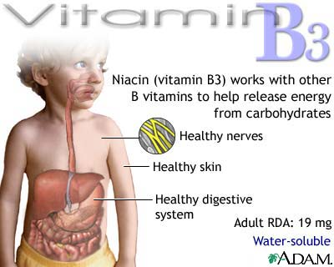
Notes:
Alternate name:
Niacin, nicotinic acid, nicotinamide, niacinamide
Precursor is dietary tryptophan (amino acid)

Slide 16
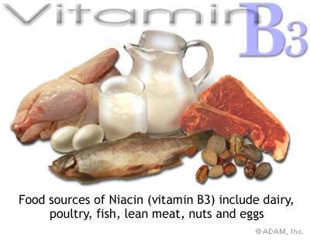
Notes:
Sources:
Milk, eggs, meat, poultry, fish, whole grain, enriched breads, and ALL PROTEIN CONTAINING FOODS

Slide 17
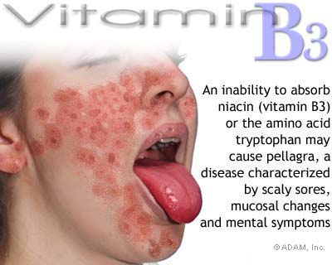
Notes:
Pellagra is a disease of deficiency of niacin (vitamin B3) which causes problems in the skin and the digestive and nervous systems
Deficiency
PELLAGRA (4Ds)
Diarrhea, Dermatitis, Dementia and Depression
Inflamed bright red tongue

Slide 18
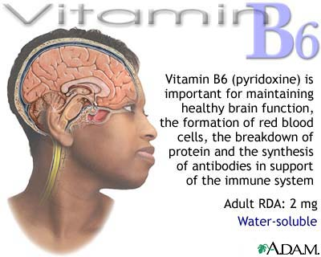
Notes:
Other names:
Pyridoxine, pyridoxal, pyridoxamine
Function:
Vitamin B-6 plays a role in the synthesis of antibodies by the immune system.
Vitamin B-6 helps maintain normal nerve function and also acts in the formation of red blood cells.
It is also required for the chemical reactions needed to digest proteins.
The higher the protein intake, the more the need for vitamin B-6.
Fxn:
Used in amino acid and fatty acid metabolism
Helps to make rbcs
Pyridoxine, or vitamin B6, boosts the manufacture of antibodies to support the immune system
Large doses of B6 can cause numbness and neurological problems.

Slide 19
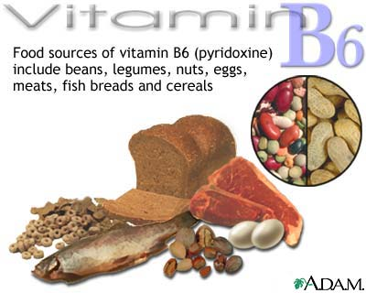
Notes:
EASILY DESTROYED BY HEAT
Deficiency:
Microcytic anemia (small cell type)
Scaly dermatitis

Slide 20
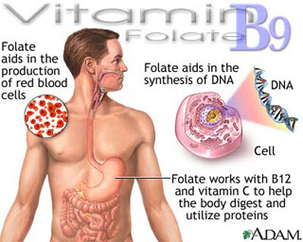
Notes:
Folic acid (folate)
Alternative Names:
Vitamin B-9; Folate; Pteroylglutamic acid
Function:
Folic acid works along with vitamin B-12 and vitamin C to help the body digest and utilize proteins and to synthesize new proteins when they are needed.
It is necessary for the production of red blood cells and for the synthesis of DNA (which controls heredity and is used to guide the cell in its daily activities).
Folic acid also helps with tissue growth and cell function.
Helps to increase appetite when needed and stimulates the formation of digestive acids.
Synthetic folic acid supplements may be used in the treatment of disorders associated with folic acid deficiency and may also be part of the recommended treatment for certain menstrual problems and leg ulcers.

Slide 21
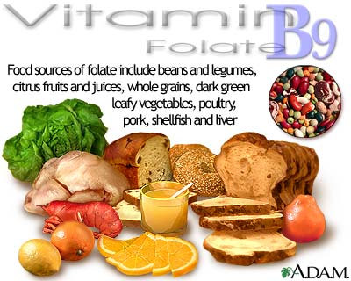
Notes:
Source:
Green leafy veg, legumes, seeds, liver
Easily destroyed by heat and oxygen
Deficiency
Smooth red tongue
MACROLYTIC or MEGALOBLASTIC ANEMIA
Pregnant women who are thinking of becoming pregnant or who are pregnant often require additional supplementation of folic acid.
Adequate folic acid is important for pregnant women because it has been shown to prevent some kinds of birth defects, including neural tube defects such as spina bifida. Many foods are now fortified with folic acid to help prevent these kinds of serious birth defects.

Slide 22
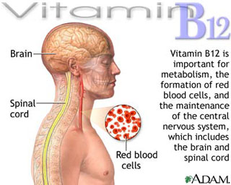
Notes:
Vitamin B12 is important for metabolism. Metabolism within the body includes the processes of energy generation and use; including nutrition, digestion, absorption, elimination, respiration, circulation, and temperature regulation.
Vitamin B12
Other names: Cobalamin
Function:
Vitamin B-12, like the other B vitamins, is important for metabolism.
It helps in the formation of red blood cells and in the maintenance of the central nervous system.

Slide 23
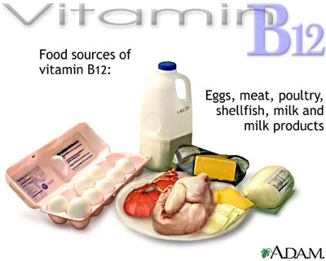
Notes:
Sources:
Animal products (meat, fish, poultry, shellfish, milk cheese)
Easily DESTROYED BY MICROWAVE COOKING
The human body stores several years worth of vitamin B12, so nutritional deficiency of this vitamin is extremely rare.
However, people who follow a strict vegetarian diet and do not consume eggs or dairy products may require vitamin B12 supplements.
Deficiency:
Pernicious anemia – due PRIMARILY to the lack of intrinsic factor in the stomach and not necessarily due to vitb12 deficiency
Large cell type anemia is known as either MEGALOBLASTIC or MACROCYTIC anemia
Smooth Beefy red tongue – glossitis
Toxicity
None reported
Test for absorption of Vit B12: SCHILLING TEST

Slide 24
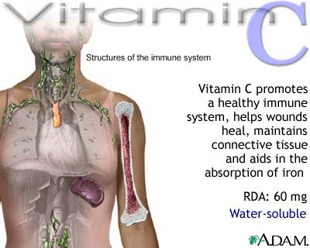
Notes:
Antioxidants are substances or nutrients in our foods which can prevent or slow the oxidative damage to our body. When our body cells use oxygen, they naturally produce free radicals (by-products) which can cause damage. Antioxidants act as "free radical scavengers" and hence prevent and repair damage done by these free radicals. Health problems such as heart disease, macular degeneration, diabetes, cancer etc are all contributed by oxidative damage.
Vitamin C
Vitamin C, also known as ascorbic acid, is a water-soluble vitamin.
Function
Vitamin C is required for the synthesis of collagen, an important structural component of blood vessels, tendons, ligaments, and bone.
Vitamin C also plays an important role in the synthesis of the neurotransmitter, norepinephrine.
Neurotransmitters are critical to brain function and are known to affect mood.
In addition, vitamin C is required for the synthesis of carnitine, a small molecule that is essential for the transport of fat to cellular organelles called mitochondria, for conversion to energy
Recent research also suggests that vitamin C is involved in the metabolism of cholesterol to bile acids, which may have implications for blood cholesterol levels and the incidence of gallstones
Vitamin C is also a highly effective antioxidant.
Even in small amounts vitamin C can protect indispensable molecules in the body, such as proteins, lipids (fats), carbohydrates, and nucleic acids (DNA and RNA) from damage by free radicals and reactive oxygen species that can be generated during normal metabolism as well as through exposure to toxins and pollutants (e.g. smoking).
Vitamin C may also be able to regenerate other antioxidants such as vitamin E

Slide 25
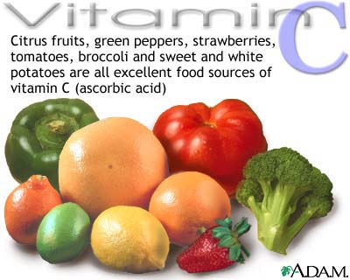
Notes:
Deficiency
Scurvy
Severe vitamin C deficiency has been known for many centuries as the potentially fatal disease, scurvy.
By the late 1700's the British navy was aware that scurvy could be cured by eating oranges or lemons, even though vitamin C would not be isolated until the early 1930's.
Symptoms:
bleeding and bruising easily
hair and tooth loss
joint pain and swelling
Such symptoms appear to be related to the weakening of blood vessels
connective tissue
and bone
which contain collagen.
Early symptoms of scurvy such as fatigue may result from diminished levels of carnitine – needed to derive energy from fat, or decreased synthesis of the neurotransmitter norepinephrine
Scurvy is rare in developed countries because it can be prevented by as little as 10 mg of vitamin C daily

Slide 26
Fat Soluble Vitamins

Slide 27
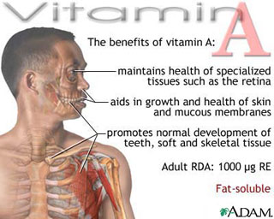
Notes:
Vitamin A
Alternative Names:
Retinol; retinal, retinoic acid; precursors are CAROTENOIDS such as beta-carotene
Function:
Vitamin A helps form and maintain healthy teeth, skeletal and soft tissue, mucous membranes, and skin.
It is also known as retinol because it generates the pigments in the retina.
Vitamin A promotes good vision, especially in dim light. It may also be required for reproduction and breast-feeding.
Vitamin A, also known as retinol, is essential to the formation of visual purple in the retina, which allows vision in dim light.
Beta carotene, the precursor to vitamin A found in vegetables, has antioxidant properties, which means it protects cells from the daily toxic damage of oxidation.

Slide 28
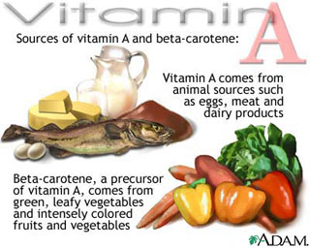
Notes:
Deficiency:
Hypovitaminosis A
Anemia
Night blindness
Xerosis – abnormal drying of the skin and mucous membranes due to vit a deficiency
Xeropthalmia – progressive blindness caused by severe vit a deficiency
Also the collective term for eye symptoms of vit A deficiency
Kidney stones
Toxicity:
Hypervitaminosis A
Loss of hemoglobin and K by rbcs
Jaundice
Amenorrhea
Hepatomegaly, spleenomegaly

Slide 29
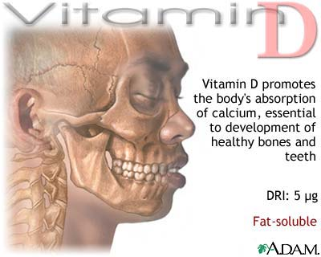
Notes:
Vitamin D
Vitamin D is a fat-soluble vitamin that is used by the body in the absorption of calcium.
Alternate name:
Calciferol
Calcitriol
Cholecalciferol (animal version)
Function:
Vitamin D promotes the body's absorption of calcium, which is essential for the normal development and maintenance of healthy teeth and bones. Calcium is also important to nerve cells, including the brain and participates in the blood coagulation process.
Vitamin D also helps maintain adequate blood levels of calcium and phosphorus.

Slide 30
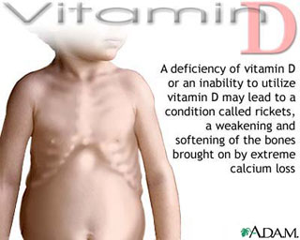
Notes:
Because vitamin D is essential for the body's utilization of calcium, a deficiency may result in severe loss of calcium and consequently a softening and weakening of bones.
RICKETS in children
OSTEOMALACIA in adults
OSTEOPOROSIS deficiency in vit D promotes losses of calcium from the bones

Slide 31
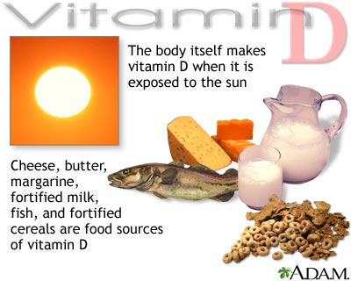
Notes:
In addition, the body manufactures vitamin D when exposed to sunshine, and it is recommended people get 10 to 15 minutes of sunshine 3 times a week.

Slide 32
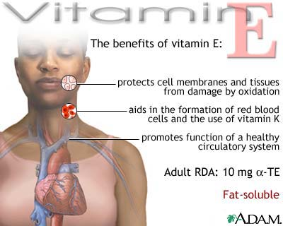
Notes:
Other names:
Alpha-tocopherol
Function
Antioxidant

Slide 33
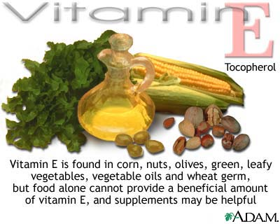
Notes:
Deficiency:
Breaking of RBCs (HEMOLYSIS)
Anemia
Toxicity
Interferes with anticlotting medication
Easily destroyed by heat and oxygen

Slide 34
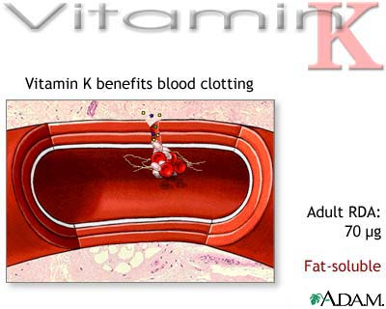
Notes:
Other names:
Phylloquinone, menaquinone, menadione, naphthoquinone
All the fat-soluble vitamins (A, D, E and K) are inhibited by the ingestion of mineral oil because they dissolve in the oil and are lost.
Vitamin K is a fat-soluble vitamin that plays an important role in blood clotting.
Function:
Vitamin K is known as the clotting vitamin, because without it blood would not clot.
It also takes part in the synthesis of bone proteins that regulate blood calcium

Slide 35
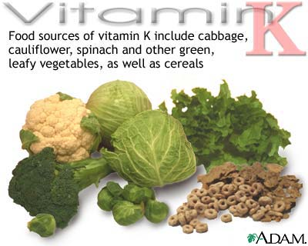
Notes:
Deficiency:
Hemmorhaging
Produced in part by bacterial synthesis in the digestive tract (e. coli)
ANTIDOTE FOR WARFARIN AND COUMADIN (anticoagulants used in the tx of CVA and embolism)
HEPARIN antidote is PROTAMINE SULFATE
Minerals are discussed in FLUIDS and ELECTROLYTES concept

